Slide 1
Journal club HEART.BMJ.COM
Dr Eisazadeh
Maryam roshani Zahra mashhadi

Slide 2
ARTICLE TITLE
Reducing weight and increasing physical activity in
people at high risk of cardiovascular disease
a randomised controlled trial comparing the effectiveness of enhanced motivational interviewing intervention with usual care

Slide 3
INTRODUCTION
Cardiovascular disease (CVD) remains the leading cause of mortality Reduction in levels of physical
activity and rising levels of obesity are limiting the decline in CVD mortality. The most effective interventions for primary prevention of CVD in high risk individuals remain unclear.
Walking, especially with a pedometer, is promoted as a near-perfect exercise.
Lowering fat and increasing fibre, fruit and vegetable intake do reduce the risk for CVD.
Psychological processes are important in initiating and maintaining change to healthier lifestyles. One approach is to use motivational interviewing

Slide 4
METHODS
TRIAL DESIGN
This was a three-arm, parallel-group randomised controlled trial (RCT), for individuals at high risk for CVD using a partially clustered design followed-up at 12 and 24 months from baseline.
The three arms were:
enhanced motivational interviewing in a group format
enhanced motivational interviewing in an individual format
and UC

Slide 5
RANDOMISATION AND MASKING
BASELINE MEASURES
sociodemographic factors
age ,gender, self-report ethnicity, occupational status, educational attainment and marital status.
Biomedical data
height ,BMI ,waist and hip circumferences blood pressure ,glycated haemoglobin and fasting lipids.
Life- style data
alcohol intake, smoking status and physical activity
Self-reported depressive symptoms
Patient Health Question
USUAL CARE
weight loss, smoking cessation, exercise programs.

Slide 6
INTERVENTION
The theoretical framework for enhanced motivational interviewing was based on social cognitive theory. Intention formation is influenced by:
expected value or positive attitude subjective norm and self-efficacy.
The intervention was consisted of :
10 sessions over 12 months delivered by health trainers.
THE INTENSIVE PHASE
6 weekly sessions during the first 3months focused on physical activity and diet.
THE MAINTENANCE PHASE
four sessions delivered at 3, 6, 9 and 12 months.
THE TRAINING
consisted of 8 weeks of didactic learning, role-playing, group exercises and case discussions
HEALTH TRAINER’S COMPETENCY
QUALITY ASSURANCEHE

Slide 7
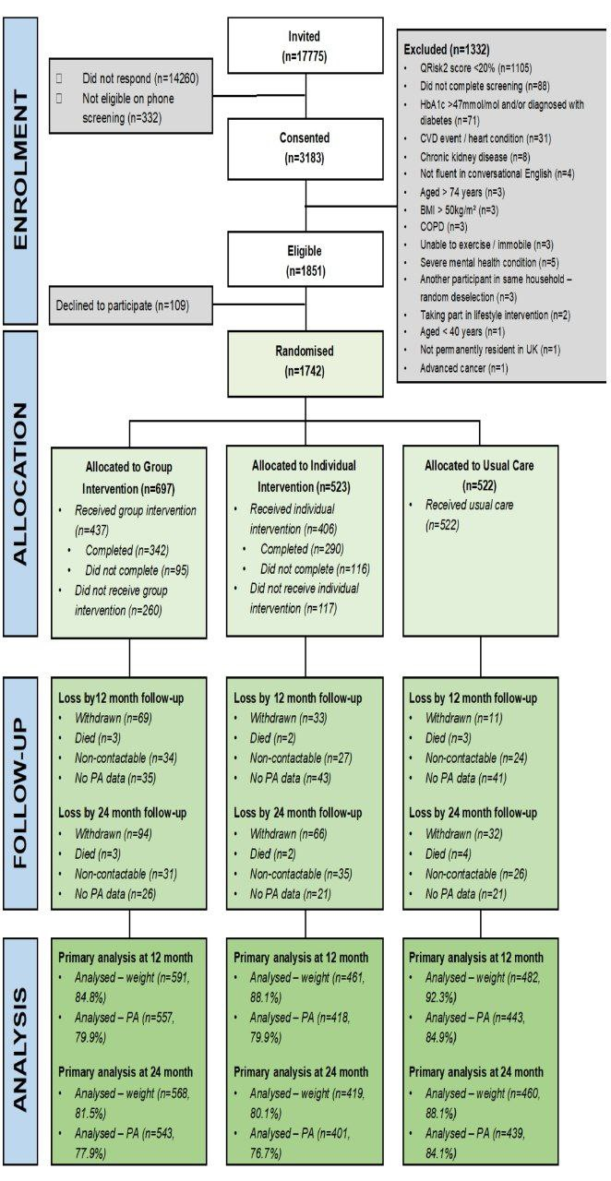

Slide 8
INTERVENTION DELIVERY AND RECEIPT
1220 participants were randomized
28.2% did not start the intervention,
17.3% started but did not complete the intervention
54.5% completed the intervention
most common reasons for participants not starting or completing the intervention:
being too busy (27.4%)
unable to contact (16.0%)
no longer interested in participating (15.5%).
LOSS TO FOLLOW UP

Slide 9
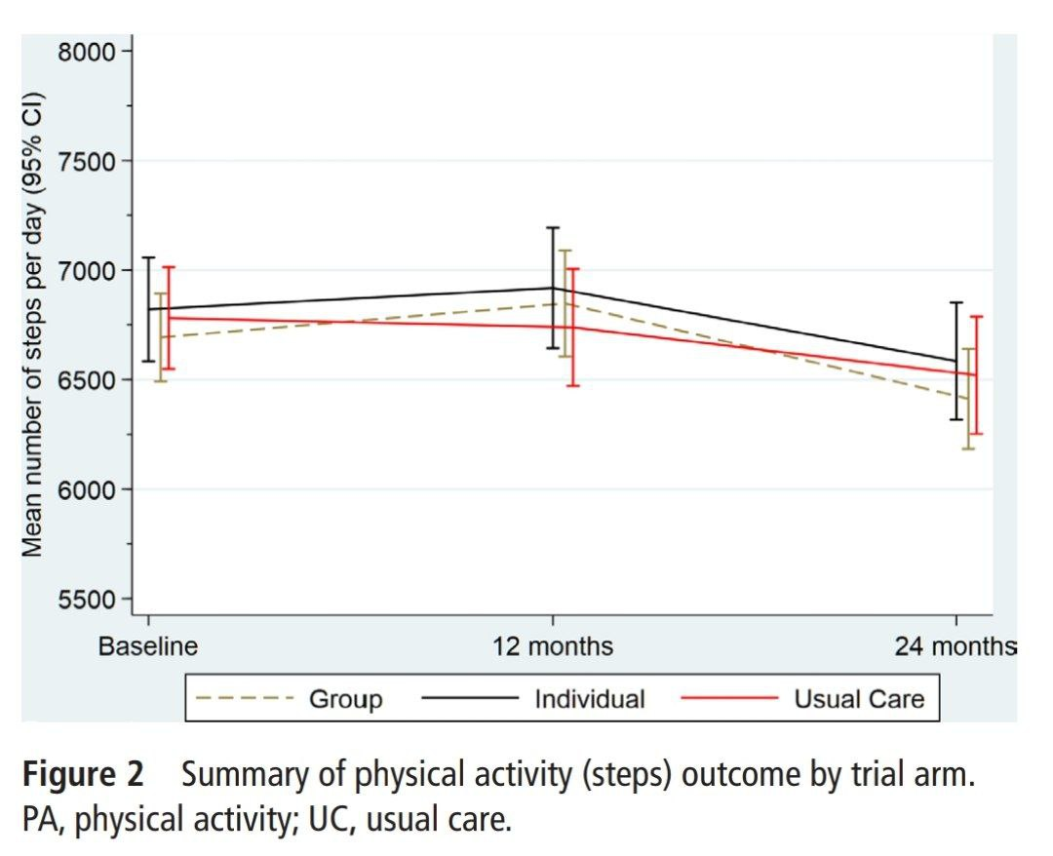
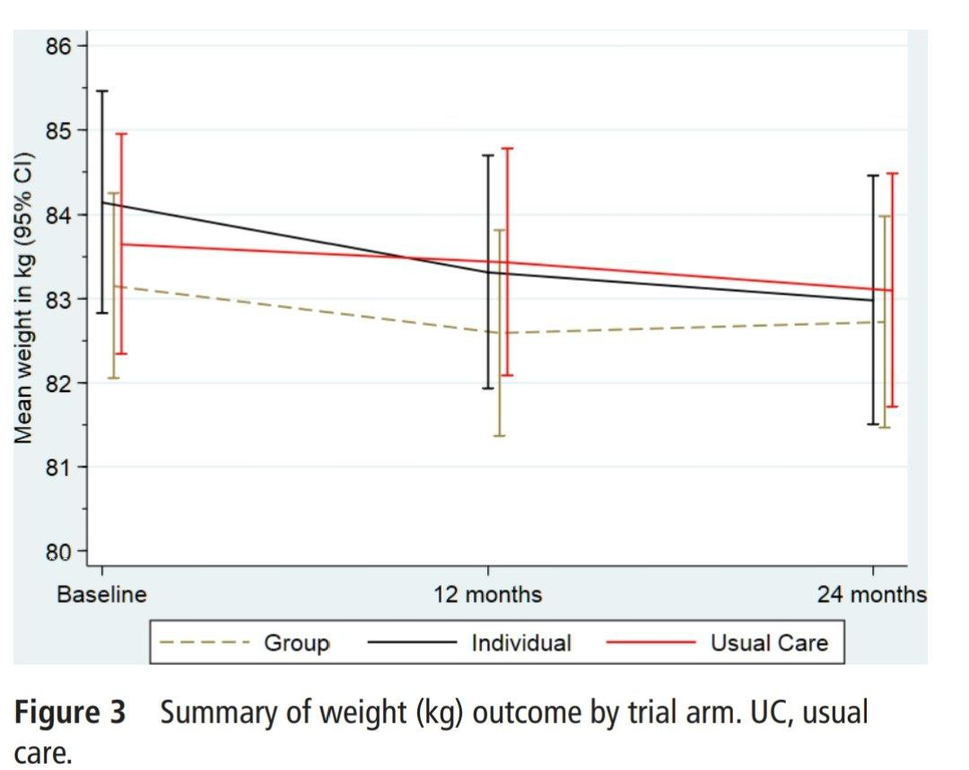
PRIMARY OUTCOMES
PHYSICAL ACTIVITY
we did not observe any differences between the group or individual arms and UC at 12 or 24 months.
WEIGHT
at 12 months, the group and individual arms had slight but significant reductions.
there were no differences at 24 months.

Slide 10
SECONDARY OUTCOMES
COST_EFFECTIVENESS
The group arm was less effective than UC and more expensive.
Individual was more expensive and more effective.
After controlling for baseline costs total costs did not differ between the three arm.
ADDVERSE EVENTS

Slide 11
DISCUSSION
Summary of the clinical effectiveness of MOVE IT:
Enhanced motivational interviewing was not effective or cost-effective in improving physical activity, weight, LDL cholesterol or QRisk2 scores in adults at high risk of CVD over 24 months compared with UC.

Slide 12
INTERPRETATION
One explanation for the negative finding is that our sample was skewed to non-modifiable risk factors in the QRisk2 algorithm (age, gender and ethnicity)
A second potential explanation is that the intervention potency was subtherapeutic.
Landmark studies have repeatedly shown that intensive life-style instruction, such as the diabetes prevention studies and weight reduction programmes do lead to significantly improved outcomes.
In these interventions, the clinically active ingredients included intensive, highly structured, prescribed
dietary and/or physical activity programmes following a counselling approach and greater emphasis on formal social support, information giving and monitoring of weight and exercise.
Our intervention did not prescribe a dietary or physical activity programme but aimed to address cognitions that resisted dietary And/or physical activity changes and to increase an individual’s intention to change.

Slide 13
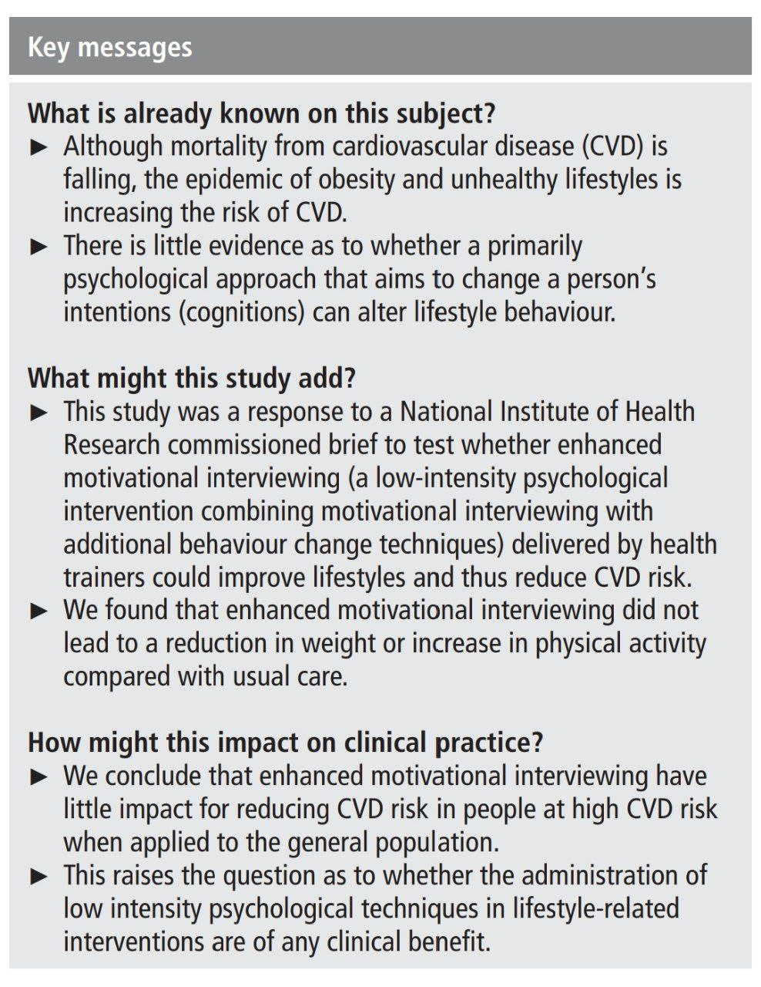

Slide 14
THANKS

