Slide 1
In the name of God
Made by Elaheh Idari
Present by Negin Rahimi

Slide 2
Global Epidemiology of Ischemic Heart Disease: Results from the Global Burden of Disease Study

Slide 3
Introduction
Cardiovascular diseases cause approximately one-third of deaths worldwide
The increasing incidence of IHD is expected to continue, due not only to the increased prevalence of obesity, diabetes, and metabolic syndrome but also to population aging
. Emerging issues with social relationships, psychological distress, and less than six hours of sleep a night also contribute to IHD in the current generation
The financial impact of IHD stems from hospitalizations, treatments, revascularization procedures, clinic visits, emergency visits, and prescribed drug treatments
the global cost of CVD in 2010 was US$863billion US$1 trillion by 2030
For health policymakers to develop effective and timely strategies to address IHD, an up-to-date analysis is needed.

Slide 4
Materials And Methods
Global Burden of Disease (GBD) it is actively maintained and updated based on research data and published epidemiological studies and governmental publications from more than 90,000 sources
it builds models and statistical estimates for health loss due to illness, injury, and risk factors. Annually, the GBD produces prevalence, incidence, death, and disability-adjusted life years (DALYs) measures
DALYs are calculated by adding YLLs (years of life lost due to premature death) and YLDs (years of life lost due to disability)
GBD, the 2017 update(from 1990 to 2017 )

Slide 5
Materials And Methods
GBD, the 2017 update(from 1990 to 2017 )
, GBD divides the world into four regions: Asia, Europe, America, and Africa.
Age-adjusted rates were used to compare annual rates from 1990 to 2017, to compensate for the effects of changes in population structure and aging.

Slide 6
Results
In 2017, we observed that IHD affects around 126 million individuals globally (1,655 per 100,000), which is estimated to be 1.72% of the world’s population

Slide 7
Region | Prevalence (rate per 100,000) | Disability - Adjusted Life Years (rate per 100,000) | Region | Prevalence (rate per 100,000) | Disability - Adjusted Life Years (rate per 100,000)
global | 1655 | 2228 | India | 1197 | 2679
Europe | 3547 | 3771 | Japan | 2928 | 1427
Germany | 3432 | 2855 | South Korea | 1352 | 704
France | 2696 | 1237 | Taiwan | 1759 | 1241
Italy | 3468 | 1831 | Saudi Arabia | 1509 | 1643
Spain | 2733 | 1503 | Iran | 1599 | 2149
Netherlands | 3502 | 1451 | Australia | 2576 | 1450
Switzerland | 2581 | 1461 | America | 1990 | 1887
Sweden | 3858 | 2192 | United States | 2929 | 2470
Turkey | 2418 | 1960 | Canada | 2335 | 1837
Russia | 4198 | 6568 | Brazil | 1685 | 1736
United Kingdom | 3337 | 1864 | Africa | 880 | 1309
Asia and Australasia | 1440 | 2272 | South Africa | 1227 | 1184
China | 1612 | 2131

Slide 9
In 2017, around nine million deaths were attributed to IHD, making it the leading cause of mortality worldwide. IHD has retained this leading position for more than two decades
In terms of regional distribution, IHD shows the highest prevalence in central and Eastern Europe (Figure 1),

Slide 10
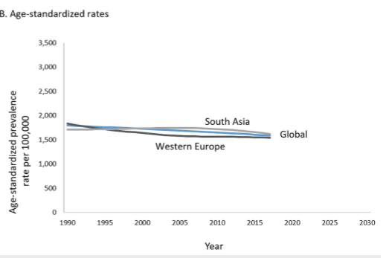
FIGURE 2: Trends in the prevalence of ischemic heart disease using unadjusted (A) and age-standardized (B) rates

Slide 11
several Eastern European countries, such as Lithuania, Bulgaria, Latvia, Estonia, and the Czech Republic, have moved up the ranks of highest prevalence. In contrast, high-income countries, such as the United Kingdom, Finland, Denmark, Germany, and Italy, moved down the ranks
Western Europe continues to show an increasing prevalence, substantially higher thanSouth Asia (the Indian subcontinent) and the rest of the world (Figure 2).

Slide 12
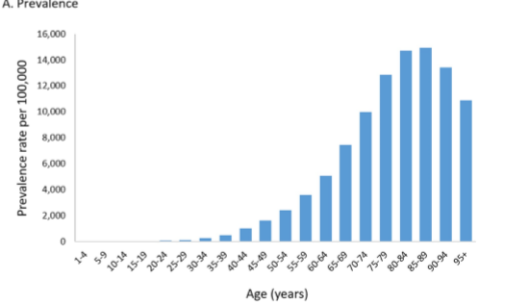
FIGURE 3: Age distribution of ischemic heart disease worldwide based on prevalence (A) and incidence (B), 2017

Slide 13
Forecasts of prevalence based on predictive models indicate that by 2030, the prevalence of IHD could increase to more than 1,845 per 1000,000, with an upper confidence estimate of 1,917 per 100,000.
Male gender is a well-known risk factor and, consequently, the prevalence of IHD was higher in men as compared to women (1,786 vs. 1,522 cases per 100,000). This difference is present in all age groups. The age of onset also appears to be earlier in men. (Figure 3).
Incidence increases from the fourth decade of life and does not decrease after that, reflecting the role of age as a risk factor. Prevalence remains higher than the incidence for all age groups, indicating the chronic nature of IHD.
. In terms of DALY, IHD is the leading cause of disability and years of life lost globally, moving from the fourth position in 1990 to the first position in 2017

Slide 14
Discussion
The number of patients diagnosed with IHD increased over the past 27 years. This increase in CVD burden has serious implications for health systems’ capacity and planning
. As this rise is partly due to population increase and aging (the incidence and prevalence of IHD increase with age), age-standardized rates are more indicative of the underlying trends
A key finding of our study is that age-standardized rates of incidence, prevalence, mortality, and burden of suffering (as indicated by DALYs) have declined over the past two decades in many regions. This may be due to increasing awareness of lifestyle factors such as cigarette smoking, obesity, and exercise

Slide 15
Discussion
Recent studies relating to the CVD burden have indicated a potential association of increased CVD burden with lower socioeconomic status and less education. Hence, the burden of IHD may be addressed by effective investment in educating the public and creating an awareness of CVD-associated risk factors and early symptoms.
The forecast of an increased disability burden due to IHD should prompt healthcare policymakers to promote strategies such as putting more emphasis on primary care and primary prevention of IHD

Slide 16
Discussion
Major challenges of IHD on the health system could be addressed by effective measures to reduce tobacco smoking. Consistent advice on a healthy diet during childhood could also reduce the development of metabolic syndrome in early adulthood. Public health measures, such as reducing total salt intake by one third, could reduce deaths due to IHD by 8%
The main limitation of our study is the reliance on secondary data. The GBD dataset relies on modeling and estimation based on primary data
Additionally, GBD does not subdivide IHD into its constituent elements such as myocardial infarction, angina, or heart failure due to ischaemic cardiomyopathy.

Slide 17
Conclusions
IHD remains the leading cause of death and premature mortality worldwide, with economic development and urbanization having the greatest impact on disease development. The present analysis provides evidence of a promising decline in age-adjusted rates in many regions. The causes of IHD are well-established, including risk factors such as calorie-dense processed foods, stress, a sedentary lifestyle, and cigarette smoking, so aggressive preventive measures are warranted to control this scourge of modern life.

Slide 18
Thanks For Your Attention

