Slide 1
به نام خدا

Slide 2
Effect of a Novel Online Group-Coaching Program to Reduce Burnout in Female Resident Physicians

Slide 3
Abstract
IMPORTANCE: Female resident physicians are disproportionately affected by burnout, which can have serious consequences for their well-being and career trajectory. Growing evidence supports the use of professional coaching to reduce burnout in resident physicians, yet individual coaching is resource intensive and infeasible for many training programs.
OBJECTIVE: To assess whether a structured professional group-coaching program for female resident physicians would lead to decreased burnout.
DESIGN, SETTING, AND PARTICIPANTS: This pilot randomized clinical trial was conducted from January 1 to June 30, 2021, among 101 female resident physicians in graduate medical education at the University of Colorado who voluntarily enrolled in the trial after a recruitment period. Surveyswere administered to participants before and after the intervention.

Slide 4
INTERVENTION: With the use of a computer-generated 1:1 algorithm, 50 participantswere randomly assigned to the intervention group and 51 participantswere randomly assigned to the control group. The intervention group was offered a 6-month, web-based group-coaching program, Better Together Physician Coaching, developed and facilitated by trained life coaches and physicians. The control group received residency training as usual, with no coaching during the study. The control group was offered the 6-month coaching program after study completion.
MAIN OUTCOMES AND MEASURES: The primary outcome of burnout was measured using the Maslach Burnout Inventory, defined by 3 Likert-type 7-point subscales: emotional exhaustion, depersonalization, and professional accomplishment. Higher scores on the emotional exhaustion and depersonalization subscales and lower scores on the professional accomplishment subscale indicate higher burnout. Secondary outcomes of impostor syndrome, self-compassion, and moral injury were assessed using the Young Impostor Syndrome Scale, Neff’s Self-Compassion Scale–Short Form, and the Moral Injury Symptom Scale–Healthcare Professionals, respectively. An intention-totreat analysis was performed.

Slide 5
RESULTS: Among the 101 female residents in the study, the mean (SD) age was 29.4 (2.3) years, 96 (95.0%) identified as heterosexual, and 81 (80.2%) identified as White. There were 19 residents (18.8%) from surgical subspecialties, with a range of training levels represented. After 6 months of professional coaching, emotional exhaustion decreased in the intervention group by a mean (SE) of 3.26 (1.25) points compared with a mean (SE) increase of 1.07 (1.12) points in the control group by the end of the study (P = .01). The intervention group experienced a significant reduction in presence of impostor syndrome compared with controls (mean [SE], −1.16 [0.31] vs 0.11 [0.27] points; P = .003). Self-compassion scores increased in the intervention group by a mean (SE) of 5.55 (0.89) pointscompared with a mean (SE) reduction of 1.32 (0.80) points in the control group (P < .001). No statistically significant differences in depersonalization, professional accomplishment, or moral injury scores were observed. Owing to the differential follow-up response rates in the treatment groups (88.2%in the control group [45 of 51]; 68.0%in the intervention group [34 of 50]), a sensitivity analysis was performed to account for the missing outcomes, with similar findings.
CONCLUSIONS AND RELEVANCE: In this randomized clinical trial, professional coaching reduced emotional exhaustion and impostor syndrome scores and increased self-compassion scores among female resident physicians.

Slide 6
Introduction
Burnout, referring to feelings of exhaustion, negativism, and reduced personal efficacy at work,affects 25%to 30% of individuals in the US and 44%to 80% of medical trainees and physicians.Physician burnout is associated with increased errors, higher patient mortality rates, depression, suicidal ideation, and high job turnover.2,3 Physician burnout has been described as a “public health crisis that urgently demands action.”4 The culture leading to burnout begins in medical school and worsens throughout training.1,5-7 Female resident physicians are disproportionately affected by burnout, likely contributing to the “leaky pipeline” in academic medicine, where women begin as 46%of the workforce yet represent only 23%of full professors and 18%of chairsAlthough burnout is well defined, its solution is less clear. Many system-level solutions have been offered; however, neither increased salary, improved electronic medical records, nor reduced hours consistently decrease burnout.1,7,13 Individual-level solutions, such as mindfulness, time off,yoga, and structured mentorship, have been offered, and these solutions have mitigated burnout in other fields but have not been similarly effective among physicians.

Slide 7
Physician burnout likely stems from multiple factors affecting perceptions and habits.A narrative review of resident physician burnout cites a perception of stressful work relationships, demanding attending physicians, and a culture in which residents’ needs are inconsequential, correlating with greater burnout.16 Protective factors include maintaining optimism and avoiding a mentality of delayed gratification,16 suggesting that resident physician perception is a key contributor to burnout.
Professional coaching uses inquiry around perceptions, beliefs, and habits to define, reframe, and align work with personal values.17,18 Coaching differs from mentoring, advising, and teaching in that it uses inquisition and metacognition, rather than advice, to help the individual receiving coaching to manage thoughts, feelings, and actions, to move toward fulfillment. Unlike therapy, coaching does not diagnose or clinically treat the individual receiving coaching. When supported institutionally, coaching is highly accessible and does not require insurance approval or a copay. Although coaching is widely used in corporate environments, it is relatively new in academic medicine.
Available literature shows that coaching may reduce burnout and improve well-being among physicians and trainees.17,20-23 However,most studies rely on resource-intensive interventions and use variably trained coaches and in-person sessions that are challenging to incorporate and scale within graduate medical education.20-24We posited that a 6-month, web-based group-coaching program led by certified physician coaches would decrease burnout among resident physicians. Here, we describe the results from a pilot randomized clinical trial of our coaching program, Better Together Physician Coaching (hereineafter referred to as Better Together).

Slide 8
Methods
Study Design, Setting, and Participants
We piloted a randomized clinical trial of a group life-coaching program, Better Together, with 101 selfreported female resident physicians in graduate medical education at the University of Colorado, a tertiary care center with academic, Veterans Health Administration, safety-net, and communitybased settings. All female-identifying University of Colorado residents were eligible to participate and were recruited through email.We initially planned to limit enrollment to 20 participants but received 100 participation requests, so we adjusted our study design to accommodate and analyze efficacy in a pilot randomized clinical trial with a waiting list control group. Information on race and ethnicity was reported by the participants. Participation was voluntary, and all participants provided written informed consent. The intervention occurred between January 1 and June 30, 2021, followed the Consolidated Standards of Reporting Trials (CONSORT) reporting guideline for trial studies, and was approved by the Colorado Multi-Institutional Review Board. The study protocol is available in Supplement.

Slide 9
Randomization, Allocation Concealment, and Follow-up
Participants were randomly assigned using a computer-generated 1:1 algorithm. Randomization was stratified based on postgraduate year (1, 2, or 3) and by specialty: surgical (eg, general surgery and obstetrics and gynecology) vs nonsurgical specialty (eg, internal medicine and pediatrics).Participants were offered a baseline (prior to randomization) and 6-month (end of intervention) survey (Figure 1).

Slide 10
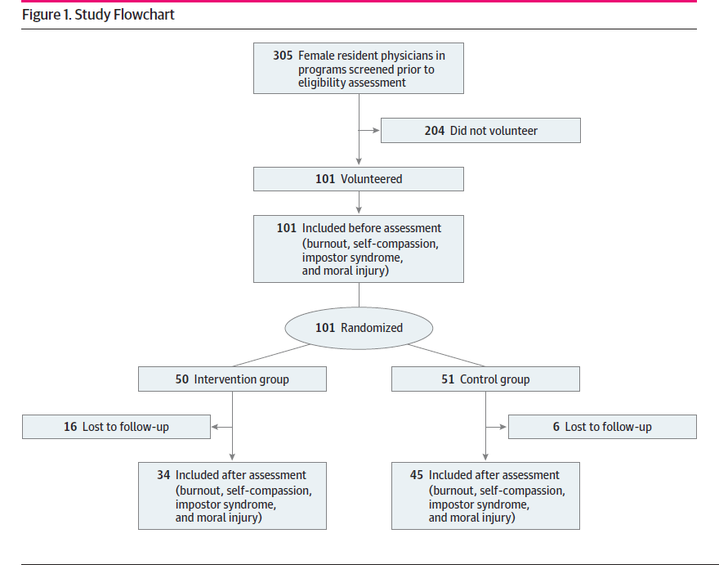
Figure 1.

Slide 11
Description of Intervention
Better Together, a 6-month, web-based group-coaching program, was developed by 2 internal medicine physicians and professional life coaches (T.F. and A.M.). The coaches were certified by The Life Coach School, a thought-based coaching institution with training in both group and individual coaching. The Better Together curriculum was housed on a members-only, password-protected website. Participants could participate in any or all of the following: (1) 2 group-coaching calls per week scheduled on week days at 7 PM on a video-conferencing platform where up to 5 participants could be coached live on any topic (these calls were recorded to allow for later asynchronous viewing), unlimited anonymous written coaching in an “Ask for Coaching” forum where participants could submit a narrative reflection and receive a written coaching response published on the website, and weekly self-study modules (videos and worksheets) on topics including goal setting, growth mindset, receiving critical feedback, impostor syndrome, and perfectionism. Program facets are outlined in Table 1 and described in detail in the eAppendix in Supplement . Ininstances where coaches supervised participants in a clinical setting, the coaches recused themselves from participant assessment (including serving on the clinical competency or promotionscommittee) to avoid conflict of interest.

Slide 12
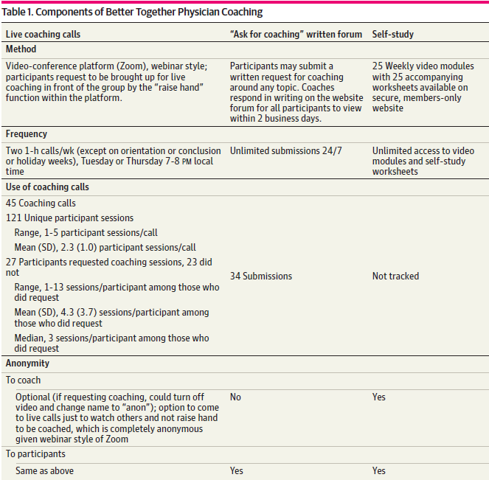

Slide 13
Study Groups
Participants randomly assigned to the intervention group were offered the coaching program. They were not given protected time to participate and carried the same clinical workload and schedules as participants randomly assigned to the control group. Control group participants received no intervention and were offered the coaching program after the study conclusion (from July to December 2021).
Study Outcomes
Baseline and end-of-study surveys were administered electronically through the Research Electronic Data Capture system. The survey contained questions on demographic characteristics and validated instruments measuring dimensions of well-being.

Slide 14
Primary Outcome: Burnout
Burnout was measured using the Maslach Burnout Inventory (MBI).26 The MBI is defined by 3 subscales: (1) emotional exhaustion (EE; feeling emotionally exhausted because of work [9 items]), (2)depersonalization (DP; detached and impersonal treatment of patients [5 items]),(3) and professional accomplishment (PA; beliefs around competence and success at work [8 items]). Each item is a 7-point question on a Likert-type scale. Higher scores on the EE and DP subscales and lower scores on the PA subscale indicate higher burnout.We used the most commonly applied thresholds for the presence of EE , DP , and low PA and we considered physicians with EE to have at least 1 manifestation of burnout. Emotional exhaustion is a key construct in health care–related burnout; in multiple samples of physicians, a 1-point increase in the EE subscale score has been associated with a 7%increase in suicidal ideation and a 5%to 6%increase in major medical errors.

Slide 15
Secondary Outcomes: Impostor Phenomenon, Self-compassion, and Moral Injury
Secondary outcomes included the Young Impostor Syndrome Scale score, which is an 8-item measurement of impostor syndrome with yes or no scoring, where a score of 5 or more indicates the presence of impostor syndrome and a score of less than 5 indicates no impostor syndrome. Neff’s Self-Compassion Scale–Short Form is a 12-item measurement of self-compassion, where higher scores indicate greater self-compassion (scores of 1.0-2.49 are considered to be low, scores of 2.5-3.5 are moderate, and scores of 3.51-5.0 are high). The Moral Injury Symptom Scale–Healthcare Professionals is a 10-item Likert scale measurement of moral injury, where the higher scores indicate greater moral injury.

Slide 16
Power Calculation
A sample size of 100 was chosen based on the capacity to provide the intervention to 50 resident physicians. Assuming a conservative assumption of zero correlation between 2 measurements for the same individual, with 80% power (α = .05, 2-sided), a mean (SD) standardized effect size of 0.8 (1.0) was detectable. With the use of SDs for the MBI components from other literature,this corresponds to detecting a difference in mean (SD) values between the groups of 7.9 (9.8) in EE, 4.8 (6.0) in DP, and 5.1 (6.4) in PA.

Slide 17
Statistical Analysis
Statistical analysis was conducted using an intention-to-treat analysis. Descriptive statistics were computed for the respondent characteristics overall and by group, with baseline comparisons made using the Wilcoxon rank sum test for continuous covariates and the Fisher exact test or the χ2 test for categorical covariates.We similarly compared the characteristics of postsurvey responders with those of nonresponders. To evaluate the intervention effect, we used a linear mixed model to use all available data without excluding the female resident physicians who did not complete follow-up surveys. In this model, we included the main effects of period (baseline vs after intervention), treatment (intervention vs control), and the interaction between period and treatment. The interaction effect represents the difference in the change from baseline to after intervention between the groups.
Owing to the differential follow-up response rates in the treatment groups (88.2%control [45 of 51]; 68.0%intervention [34 of 50]), we performed sensitivity analyses to assess the potential effect of missing follow-up survey data on outcomes.We used multiple imputation to impute the missing scores and a 2-sample t test to analyze the difference in the changes in scores between the treatment groups. Multiple imputation by chained equations was performed using 10 imputed data sets, and the imputation model for each score included baseline characteristics, treatment assignment, and baseline score. We also performed a sensitivity analysis in which the baseline score was carried forward for those with missing follow-up scores. All P values were from 2-sidednhypothesis tests, and statistical significance was assessed at P <.05. All analyses were performed using R, version 4.0.4 (R Group for Statistical Computing).

Slide 18
Results
Participants
Within 2 weeks of recruitment, 101 female resident physicians from 12 graduate medical education programs at the University of Colorado enrolled in Better Together. All participants completed the baseline survey, and 50 were randomly assigned to the intervention group. By self-report, the mean (SD) age of the participantswas 29.4 (2.3) years, all participants identified as cisgender female, most (96 [95.0%]) were heterosexual, and 81 (80.2%) were White. There were 19 resident physicians (18.8%) from surgical specialties, and multiple training levels were represented (Table 2).

Slide 19
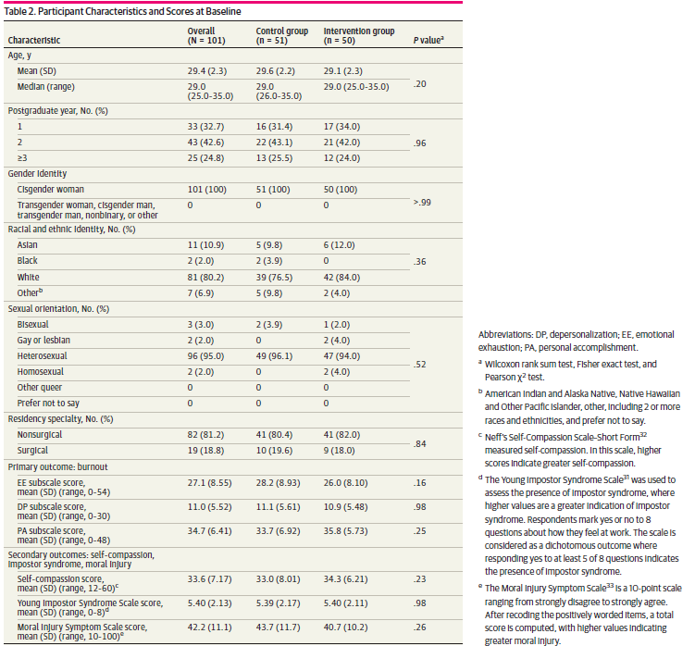

Slide 20
There were no significant differences in baseline characteristics or scale scores between the intervention and control groups. Of the 101 initial participants, 79 responded to the follow-up survey (78.2% response rate). Of those who did not complete the follow-up survey, a higher proportion were participants in the intervention group (72.7%[16 of 22]; P = .01). Otherwise, no significant differences were noted in the baseline characteristics or scale scores between those who did and those who did not complete the follow-up survey (eTables 1 and 2 in Supplement 2).

Slide 21
Engagement
Forty-five 1-hour group-coaching calls occurred during the study. Of 52 potential calls, 5 were not completed owing to holidays, scheduling needs, or recording errors, and 2 were designated “orientation” and “farewell,” respectively, and did not contain coaching content. Over the 45 calls, 27 participants requested and received coaching in 121 unique sessions, each lasting between 10 and 30 minutes. Among the 27 participants who received live coaching, the number of coaching sessions per participant ranged from 1 to 13 (mean [SD], 4.3 [3.7]; median, 3). The mean (SD) number of individuals coached per call was 2.3 (1.0).We received 21 submissions for anonymous written coaching on the Ask for Coaching forum.

Slide 22
Primary Outcome: Burnout
There was a significant difference in the change in mean score of the EE subscale of the MBI from baseline to after the intervention between the intervention group and the control group. Participants in the intervention group experienced a reduced mean (SE) EE score, while the control group experienced an increased mean (SE) EE score (−3.26 [1.25] vs 1.07 [1.12]; P = .01) (Figure 2; Table 3).
Both groups experienced an improvement in mean (SE) DP and PA scores, whichwas slightly greater in the intervention group; however, this improvement was not statistically significant (mean [SE] scores in intervention group vs control group: DP, −1.06 [0.64] vs −0.03 [0.58]; P = .23; and PA, 1.16 [0.83] vs 0.25 [0.75]; P = .41).

Slide 23
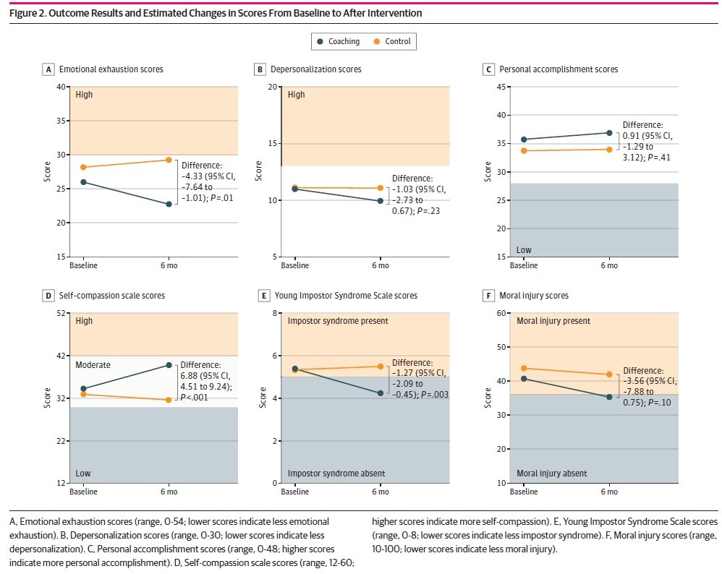

Slide 24
Secondary Outcomes: Impostor Syndrome, Self-compassion, and Moral Injury
Participants in the intervention group had significantly reduced impostor syndrome symptom scores from baseline, while participants in the control group had increased scores (mean [SE] scores, −1.16 [0.31] vs 0.11 [0.27]; P = .003) (Table 3). The intervention group also had improved self-compassion scores compared with the control group (mean [SE] scores, 5.55 [0.89] vs −1.32 [0.80]; P < .001). Participants in the intervention group had a greater reduction in moral injury scores compared with participants in the control group, although this difference was not statistically significant (mean [SE] scores, −5.39 [1.62] vs −1.83 [1.47]; P = .10). Similar results were obtained using multiple imputation and when baseline scores were carried forward for missing follow-up scores (eTable 3A and 3B in Supplement 2).

Slide 25
Discussion
In this pilot randomized clinical trial, participants who received coaching had a statistically significant reduction in EE and impostor syndrome scores and showed improvement in self-compassion scores. The magnitude of the reduction in EE scores was substantial and was higher than in previously described wellness interventions. We did not find significant differences in the PA or DP MBI scale scores between the 2 treatment groups, and the differences in moral injury scores did not reach statistical significance.We encountered unanticipated demand for this intervention and demonstrated that coaching in a group setting can address resident physician burnout. Our findings are consistent with prior coaching studies that showed a positive effect in some but not all aspects of physician well-being and that support the theory that more than 1 intervention may be necessary to target multiple facets of well-being. A randomized clinical trial of 6 telephone coaching sessions for primary care physicians decreased burnout and increased jobsatisfaction but did not reduce stress or turnover intention or increase job efficacy.In a study of medical residents in the Netherlands, 6 face-to-face coaching sessions over 10 months resulted in improved personal resources and reduced burnout symptoms, yet no changes were observed in work engagement or psychological flexibility. Although previous studies show that group coaching supports physicians’ professional identity formation and healthy work-life integration, these studies did not find an association between group coaching and personal well-being factors, including burnout. The group coaching in these studies had prescriptive content with preselectedtopics (eg, conflict management) and a different delivery format (ie, 3 full-day sessions and 5two-hour sessions over 4 months). In contrast, Better Together’s longitudinal, multimodalcoaching format allowed participants to have a self-paced, flexible, and customizable experience.

Slide 26
individually harnessed tool that encourages systemic commitment and individual responsibility for well-being. Better Together was designed for diverse needs and full schedules; participants could choose which modalities to use based on individual learning styles (written, verbal, or visual), goals, and competing demands.We used group coaching to cultivate a psychologically safe atmosphere in which vulnerability was normalized and traditional hierarchy was discouraged.40,41 Group coaching also supported delivery feasibility by maximizing the number of residents who received coaching per session. Although this coaching program was designed before the emergence of the COVID-19 pandemic, no changes to the format or content were required to accommodate the need for virtual participation. This unanticipated strength provided opportunities for connection and support during the pandemic. The Better Together coaching program is unique in the following domains that likely contribute to its success.

Slide 27
Use of Certified Physician Coaches
The coaches were physicians who understand the challenges of medical training. Many life coaching interventions for physicians do not use certified physician coaches but instead hire external, nonphysician consultants or rely on noncertified volunteer faculty with varying degrees of training in coaching techniques.
Asynchronous, Multimodal Content Delivery
Our asynchronous, online model allowed content to be accessed on demand. The repository of recorded calls meant that participants could still benefit even if they were unable to attend live. Residents knew that participation was voluntary and committed to maintaining confidentiality of their peers. Anonymous written coaching allowed participants to be coached in a time and place that worked for them.

Slide 28
Group Coaching Model
The group format allowed each coach to host one 1-hour call per week and to reach many participants. This wide reach would not have been feasible with a 1:1 model, and participants would not have the benefit of observing peers receiving coaching or the normalization of a culture of authenticity and vulnerability.
FutureWork
Given the need to address burnout and the promising findings of this pilot trial, our goal is to evaluate Better Together at multiple graduate medical education sites nationally.We aim to understand which components of the interventionwere most useful; examine the reproducibility of these results with a more diverse group of coaches among a larger and more diverse population of resident physicians; determine the optimal frequency, themes, and duration of coaching; and analyze the durability of the intervention.

Slide 29
Limitations
This study has some limitations. Given that this pilot randomized clinical trial was at a single institution, our sample size was based on estimated feasibility and thus underpowered to detect a meaningful effect for all outcomes. The voluntary nature of participation may reflect a selection bias toward participants having more distress than nonparticipants; however, it is also possible that others experiencing more burnout were too overwhelmed to volunteer. It is possible that observed outcome improvements accrued, in part, from expectations rather than the intervention itself. We were not funded to deliver an alternative noncoaching intervention to participants in the control group, but such an intervention is a potential way to mitigate this bias in future studies.
Although our sample of participants was demographically representative of female physician residents at the University of Colorado, participation was limited to women, and only 14 participants self-identified as underrepresented in medicine (URM; including race and ethnicity and sexual orientation). Inclusion of women was intentional because they are more affected by burnout. The number of URM participants is small and may limit the applicability of these results to other populations, where even higher rates of burnout are observed. A potential area for bias in recruitment could be in the deficiency of diversity and URM representation among the program leaders, who are both White. Additional trials are needed to explore the efficacy of this model across demographic identities, including racial, ethnic, sexual, and gender minority groups, and across a spectrum of career stages.

Slide 30
It was not feasible to blind the coaches, so they knew the identities of the participants and the participants knew which group they were in. The coaches were University of Colorado faculty members with teaching roles, which provided relatability and credibility but also introduced potential social desirability and selection biases because some participants may have opted to enroll owing to prior experience with the coaches. Both coaches are internal medicine physicians, and their identitywas included in the recruitment emails. It is possible that this disclosure affected recruitment of participants from specialties outside of internal medicine and participation in the program. We did notwant participants to perceive their participation as “graded” or measured, and thereforewe did not measure data on website or material use or coaching call attendance, which may have prevented us from identifying desirability or selection bias.
A significantly higher proportion of residents in the intervention group did not complete the postintervention survey compared with the residents in the control group. This finding could have been due to email fatigue (participants in the intervention group received 2 emails weekly regarding the program), or perhaps the participants in the control group were more motivated to fill out the postintervention survey in anticipation of receiving the intervention.We attempted to assess the effect of missing follow-up survey data on study outcomes with the sensitivity analyses (eTable 3A and 3B in Supplement 2).

Slide 31
Finally, both coaches obtained certification with personal time and funds ($18 000 for a 6-month certification course through the Life Coach School) and were supported with 10% full-time equivalents as conditions of their grant funding for the development of this program. Together, they spent a total of 45 hours in live coaching and 20 hours responding to written coaching over the course of the 6-month intervention. This program could be challenging to scale broadly for those wishing to create a similar program.
Conclusions
Life coaching for female resident physicians significantly improved EE, self-compassion, and impostor syndrome scores. The Better Together coaching program demonstrated the feasibility of using certified physician coaches to deliver group-based coaching through a multimodal delivery format. This model holds great promise for physician well-being; however, widespread adoption and long-term sustainability will depend on the institutional investment in coaching.

Slide 32


