Slide 1
Global, regional, and national burden of Parkinson’s disease, 1990–2016: a systematic analysis for the Global Burden of Disease Study 2016
Navid Amirkhani
Negin Moazedi

Slide 2
Summary:
Background Neurological disorders are now the leading source of disability globally, and ageing is increasing the burden of neurodegenerative disorders, including Parkinson’s disease. We aimed to determine the global burden of Parkinson’s disease between 1990 and 2016 to identify trends and to enable appropriate public health, medical, and scientific responses.

Slide 3
Method:
Through a systematic analysis of epidemiological studies, we estimated global, regional, and country-specific prevalence and years of life lived with disability for Parkinson’s disease from 1990 to 2016. We estimated the proportion of mild, moderate, and severe Parkinson’s disease on the basis of studies that used the Hoehn and Yahr scale and assigned disability weights to each level.

Slide 4
We jointly modelled prevalence and excess mortality risk in a natural history model to derive estimates of deaths due to Parkinson’s disease. Death counts were multiplied by values from the Global Burden of Disease study’s standard life expectancy to compute years of life lost.

Slide 5
Disability-adjusted life-years (DALYs) were computed as the sum of years lived with disability and years of life lost. We also analysed results based on the Sociodemographic Index, a compound measure of income per capita, education, and fertility.
This pattern suggested that coding practices rather than real changes over time and location were responsible, similar to what was observed for dementia.

Slide 6
Data sources:
The International Classification of Diseases ninth revision (ICD-9) codes used in cause of death analyses for Parkinson’s disease are 332 (Parkinson’s disease), 332.0 (paralysis agitans), and 332.1 (secondary parkinsonism), and the corresponding ICD-10 codes are G20 (Parkinson’s disease), G21 (secondary parkinsonism), and G22 (parkinsonism in diseases classified elsewhere).
The reference case definition for Parkinson’s disease used in many epidemiological studies is the presence of at least two of the four primary symptoms: rest tremor, bradykinesia, stiffness of the limbs and torso, and postural instability.

Slide 7
We also accepted alternative definitions, including the UK Parkinson’s Disease Society Brain Bank criteria,16 in addition to ICD-9 and ICD-10 codes, a doctor’s diagnosis of Parkinson’s disease, and the prescription of Parkinson’s disease-specific medications.
We also added 3 years of medical claims data (years 2000, 2010, and 2012) from the USA; for a disease such as Parkinson’s disease, the data from claims sources would be expected to match true prevalence under the expectation that most patients would be receiving medical attention each year. If datapoints from epidemiological studies spanned ages of more than 20 years, we split the datapoints using the age pattern from the USA, for which the most detailed age data were available.

Slide 8
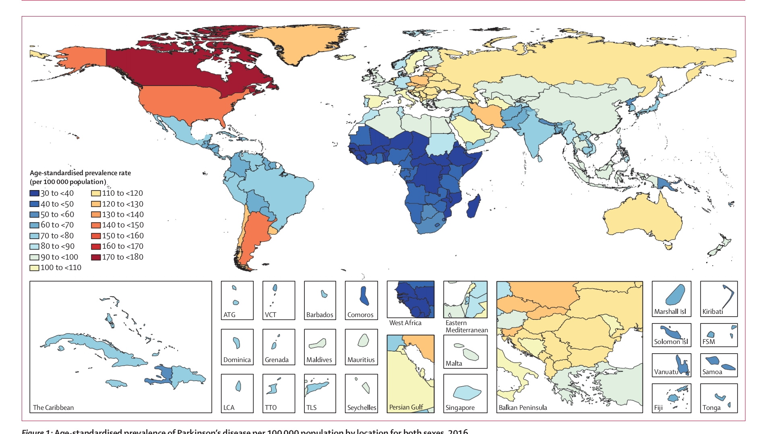

Slide 9
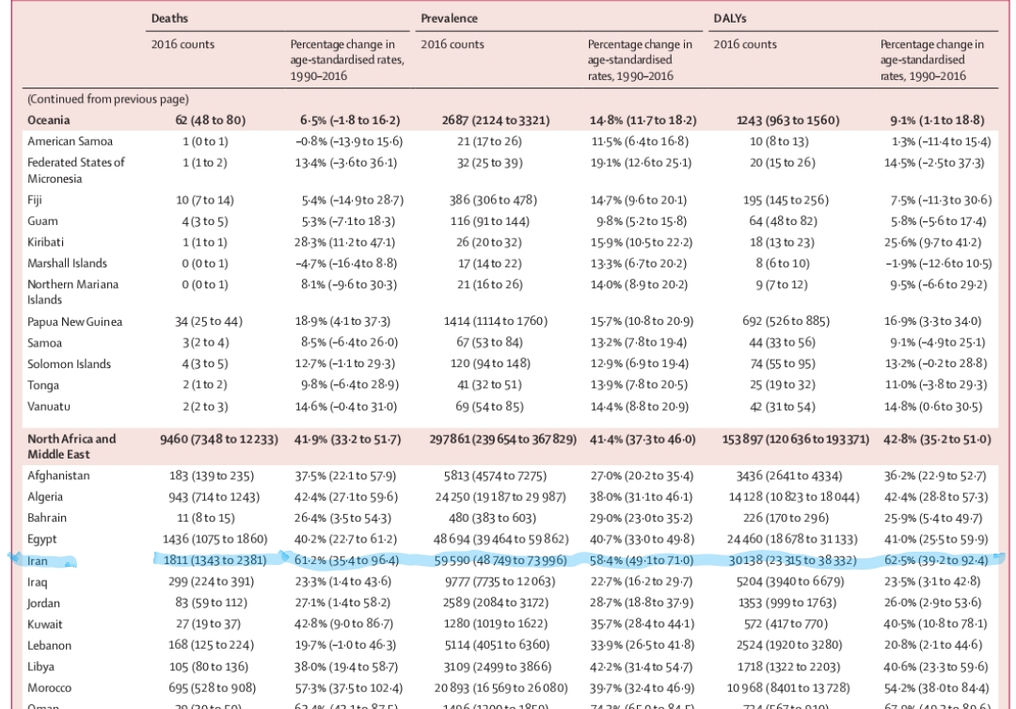

Slide 10
In 2016, 6·1 million (95% UI 5·0–7·3) individuals worldwide had Parkinson’s disease, of whom 2·9 million (47·5%) were women and 3·2 million (52·5%) were men. 2·1 million (34·4%) of these individuals were from high SDI countries, 3·1 million (50·8%) from highmiddle or middle SDI countries, and 0·9 million (14·8%) from low-middle or low SDI countries

Slide 11
The number of individuals with Parkinson’s disease in 2016 was 2·4 times higher than in 1990 (2·5 million, 95% UI 2·0–3·0).

Slide 12
The increase in the number of patients with Parkinson’s
disease worldwide between 1990 and 2016 was not explained exclusively by an increasing number of older people, because global age-standardised prevalence rates increased by 21·7% (95% UI 18·1–25·3) from 1990 to 2016 compared with an increase of 74·3% (69·2–79·6) for crude prevalence rates

Slide 13
Globally, Parkinson’s disease caused 211296 deaths (95% UI 167 771–265160; 93512, 95% UI 73702–118421, in women and 117 784, 93729–147607, in men) and 3·2 million DALYs (95% UI 2·6–4·0; 1·4 million, 95% UI 1·1–1·7, in women; 1·8 million, 1·5–2·3, in men) in 2016.

Slide 14
The number of deaths was 2·6 times higher and the number of DALYs was 2·5 times higher in 2016 than in 1990
Similar to prevalence, the increases in deaths and DALYs were lowest in high SDI countries and highest in middle SDI countries, and were seen in both men and women.

Slide 15
Age-standardised prevalence of Parkinson’s disease in 2016 was 1·40 times (95% UI 1·36–1·43) higher in men than in women; the male-to-female ratio was similar in 1990 (1·37, 95% UI 1·34–1·40). A similar pattern was seen for the rates of YLLs and YLDs according to age

Slide 16
Result:
From 1990 to 2016, age-standardised prevalence, DALY rates, and death rates increased for all global burden of disease regions except for southern Latin America, eastern Europe, and Oceania. In addition, age-standardised DALY rates generally increased across the Socio-demographic Index.
Interpretation Over the past generation, the global burden of Parkinson’s disease has more than doubled as a result of increasing numbers of older people, with potential contributions from longer disease duration and environmental factors. Demographic and potentially other factors are poised to increase the future burden of Parkinson’s disease substantially.

Slide 17
The increase in deaths from Parkinson’s disease was greater than the increase in prevalence,and the large variation in death rates between countries was suggestive of a change in coding practices rather than greater death rates among Parkinson’s disease cases.
Papers were selected if representative of the general population and identification of cases was based on our reference case definition (the presence of at least two of four primary symptoms: rest tremor, bradykinesia, stiffness of limbs and torso, and postural instability) or alternative case definitions (UK Parkinson’s Disease Society Brain Bank criteria, and doctor’s diagnosis based on International Classification of Diseases codes and prescription of medications specifically for Parkinson’s disease).

Slide 18
Severity and years lived with disability
To calculate years lived with disability (YLDs) for Parkinson’s disease, we split the overall prevalence from the second DisMod-MR 2.1 model into three severity categories using data reporting on the Hoehn and Yahr stages. We used 30 unique sources, covering nine of 21 world regions, and equated a score of 2·0 or less on the Hoehn and Yahr scale to mild Parkinson’s disease, a score of 2·5–3·0 to moderate Parkinson’s disease, and a score of 4·0–5·0 to severe Parkinson’s disease(appendix).

Slide 19
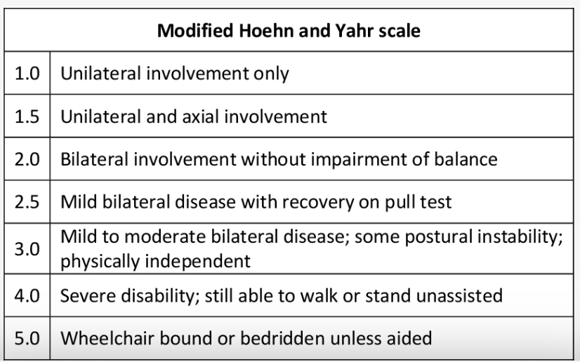

Slide 20
These data informed meta-analyses of the proportion of Parkinson’s disease that is mild, moderate, and severe. We then used these proportions to split the overall prevalence of Parkinson’s disease into the severity categories.
Finally, we multiplied the prevalence of each severity category by severity-specific disability weights to calculate YLDs. YLDs were then corrected for comorbidity with a simulation that assigned all non-fatal outcomes to hypothetical individuals and adjusted disability in patients who had multiple conditions.

Slide 21
Smoking was found to have a small, protective effect on Parkinson’s disease, and would have been expected to prevent 461194 DALYs (95% UI 324 745–599845) globally in 2016 if the association was truly causal.
The risk of Parkinson’s disease is decreased by approximately 40% among smokers. Whether this association is truly causal or explained by reverse causation or other biases is still debated.

Slide 22
Discussion
First, changes in study methods, availability of higherquality studies, and greater awareness of diagnosis might have led to better estimates of prevalence, DALYs, and deaths since 1990. For example, door-to-door studies are less likely to miss individuals who have never been diagnosed and would be missed in health records.

Slide 23
Second, increasing life expectancy is probably contributing to longer disease duration in individuals with Parkinson’s disease and thus to higher prevalence, even if incidence remains constant and individuals with Parkinson’s disease show the same time trends in mortality as the general population.Indeed, in a metaanalysis of ten studies, recent cohorts showed longer disease duration, with an increase of 2·5 years per decade.

Slide 24
Third, the increase in Parkinson’s disease burden might be linked to environmental factors tied to the growing industrialisation of the world. In general, better health is positively associated with socioeconomic level. However, with Parkinson’s disease, the opposite is true; agestandardised DALY rates due to Parkinson’s disease increased with SDI. The reason for this association is not clear.

Slide 25
Fourth, declining smoking rates in some countries, although a global health boon, might contribute to higher incidence of Parkinson’s disease.The risk of Parkinson’s disease is decreased by approximately 40% among smokers. Whether this association is truly causal or explained by reverse causation or other biases is still debated.

Slide 26
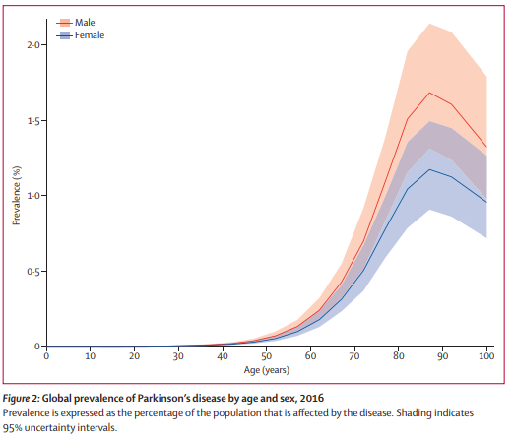

Slide 27
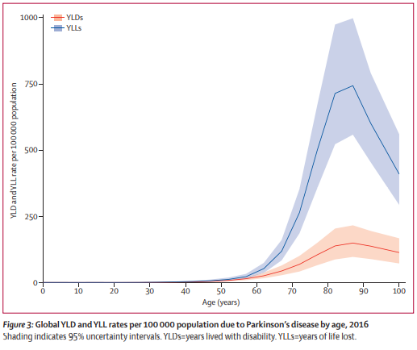

Slide 28
conclusion
This study confirms that Parkinson’s disease is about 1·4 times more frequent in men than women, and this ratio did not change substantially over the study period.
The prevalence of Parkinson’s disease increased with age. Underascertainment at older ages owing to underdiagnosis, comorbidities, or institutional care might explain the decrease seen in the oldest age groups after the peak between 85 years and 89 years.

Slide 29
Neurological disorders are now the leading source of disability in the world, and Parkinson’s disease is the fastest growing of these disorders.
As the population ages and life expectancy increases, the doubling of the number of individuals with Parkinson’s disease between 1990 and 2016 is projected to occur again in the coming generation.
To address this great health challenge will require action aimed at preventing the disease where feasible and improving the lives of those affected by the condition.
Among the potential responses available are preventing the disease (eg, by increasing physical activity earlier in adulthood and reducing exposure to pesticides),improving worldwide access to care and effective treatments (eg, levodopa), increasing funding for research (eg, to understand the underlying causes), and development of new therapies.

Slide 30
Thank’s for attention.

