Slide 1


Slide 2
ژورنال کلاب
استاد محترم:خانم دکتر شرقی
ارایه دهنده:مهسا سمین

Slide 3
Epidemiology of gastric cancer: global trends, risk factors and prevention
Article iformation:
Review article
Published in Prz Gastroentrol journal in 2019
In Department of Internal Medicine, SOVAH Health, Hospitalist, Martinsville, USA
²Hillman Cancer Center, University of Pittsburgh, PA, USA

Slide 4
Abstract
Gastric cancer remains one of the most common and deadly cancers worldwide, especially among older males.
Based on GLOBOCAN 2018 data, stomach cancer is the 5th most common neoplasm and the 3rd most deadly cancer, with an estimated 783,000 deaths in 2018.
Gastric cancer highly dependent on diet and Helicobacter pylori infection.
A better understanding of the etiology and risk factors of the disease can help reach a consensus in approaching H. pylori infection.
Dietary modification, smoking cessation, and exercise hold promise in preventing gastric cancer, while genetic testing is enabling earlier diagnosis and thus greater survival.

Slide 5
Introduction
Gastric adenocarcinomas based on their anatomic site are primarily classified as:
1: cardia Cancers of the gastric cardia arise in the region adjoining the esophageal-gastric junction and thus share epidemiological characteristics with esophageal adenocarcinoma (EAC)
2:non-cardia Non-cardia cancer, also known as distal stomach cancer, is more common and arises in the lower portion of the stomach .
Histologically the two main types of gastric cancer are the diffuse and intestinal type.

Slide 6
Epidemiology
Incidence
Over one million cases of gastric cancer are diagnosed each year around the world.
The cumulative risk of developing gastric cancer from birth to age 74 is 1.87% in males and 0.79% in females worldwide.
In developed countries, gastric cancer is 2.2 times more likely to be diagnosed in males than females.
In developing countries, this ratio is 1.83.
Incidence rates are highest in Eastern and Central Asia and Latin America
In East Asia, the average incidence of gastric cancer is 32.1 per 100,000 among males and 13.2 among females.
In North America, this incidence is 5.6 per 100,000.
The rate is lowest in North and East Africa, with only 4.7 annual diagnoses per 100,000 males.

Slide 7
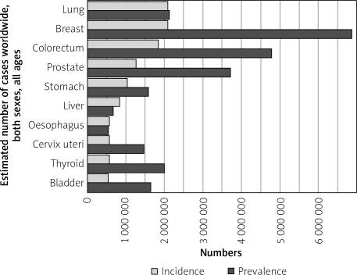
Graph shows the estimated incidence and prevalence of cancer cases worldwide, both sexes, all ages

Slide 8
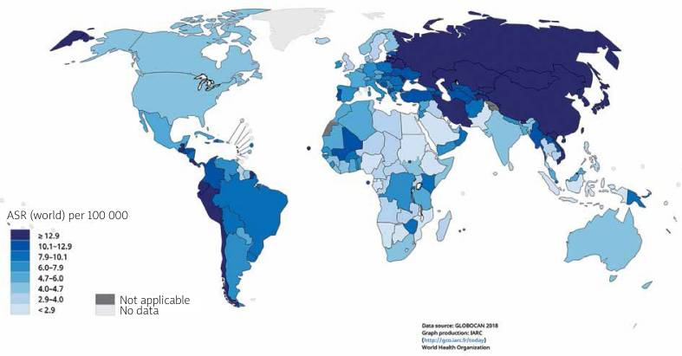
Map shows the estimated age-standardized incidence rates (world) for stomach cancer in 2018, both sexes, all ages

Slide 9
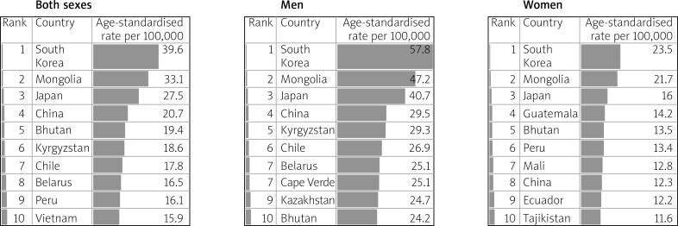
Table shows the estimated age-standardized incidence rates per 100,000 for stomach cancer in 2018, all ages, in both sexes, men and women

Slide 10
Mortality
Gastric cancer accounts for 783,000 deaths each year, making it the third most deadly cancer among males worldwide .
8.3% of all cancer deaths are attributable to gastric cancer.
The cumulative risk of death from gastric cancer, from birth to age 74, is 1.36% for males and 0.57% for females.
Mortality rates are high in eastern and central Asia and Latin America, the same regions with high incidence.
eastern and central Asian nations such as Iran, Kyrgyzstan, and Turkmenistan.

Slide 11
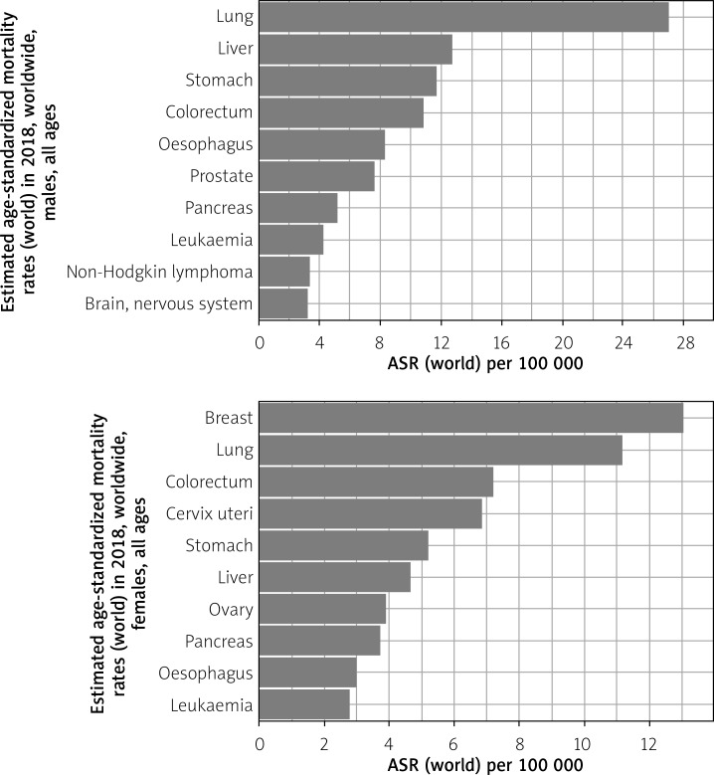
Graph shows the estimated age-standardized mortality rates (world) in 2018, worldwide, males and females, all ages

Slide 12
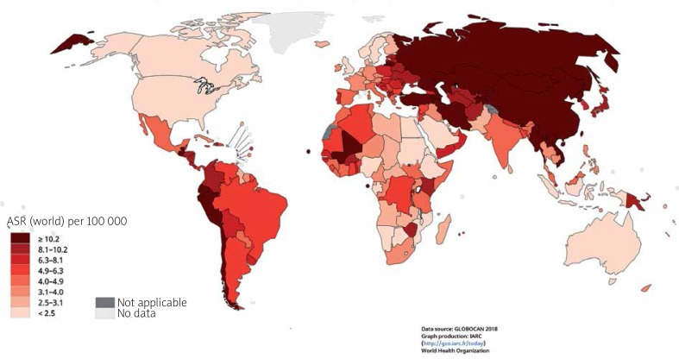
Map shows the estimated age-standardized mortality rates (world) for stomach cancer in 2018, both sexes, all ages

Slide 13
Trends
The incidence of gastric cancer has steadily declined worldwide over the past 50 years.
These declines preceded the successful reduction of H. pylori infection, and are likely attributable to changes in food preservation, such as less pickling of vegetables, and less smoking and processing of meat.
The decline has also been elicited by the greater availability of fresh fruits and vegetables.

Slide 14
Trends
As many as 90% of cases of non-cardia gastric cancer are attributable to H. pylori, which explains why the incidence of that subtype of gastric cancer has declined in step with declining infection rates .
Meanwhile, during that same period, cardia-subtype gastric cancers have increased 7-fold, especially in the developed world.

Slide 15
Survival
The 5-year survival rate for gastric cancer is 31% in the United States.
Average survival rates reflect the fact that most cases diagnosed are already metastatic.
The 5-year survival rate for pre-metastatic diagnosis is 67%. Survival is highly variable based on stage during surgical intervention.
Asian patients in the United States tend to have a better prognosis than Caucasians.
Asians have a 12% higher 5-year survival rate.
The average 5-year survival rate in Europe is 26%, higher than in the UK but lower than that of the US.

Slide 16
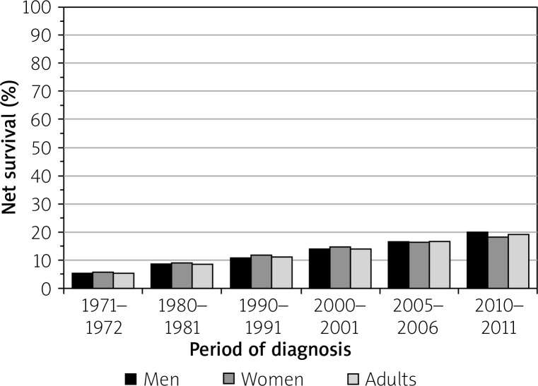
Bar chart of stomach cancer, age-standardized 5-year net survival, adults (aged 15–99), England and Wales, 1971–2011

Slide 17
Etiology
Ninety-five percent of cancers of the stomach are adenocarcinomas
Non-cardia cancers are brought about by chronic gastritis, inflammation that is associated with H. pylori atrophic gastritis.
Risk factors: H. pylori infection, low socioeconomic status, and dietary factors
The pathogenesis of cardia cancer remains unclear, although two distinct etiologies have been proposed: one is associated with gastroesophageal reflux disease (GERD) and resembles esophageal adenocarcinoma.
Risk factors: obesity and GERD

Slide 18
Etiology
These cancers are further histologically divided into:
the intestinal (well-differentiated):is the more common, with the highest incidence among older males, but also carries a better prognosis
the diffuse (undifferentiated): affects younger people and frequently females.

Slide 19
Risk factors
1. Genetics
2. Helicobacter pylori
3. Gastric ulcer
4. Gastroesophageal reflux disease
5. Smoking
6. Alcohol
7. Chemical exposure
8. Diet
9. Obesity
10. Pernicious anemia

Slide 20
Risk factors
11. Gastric surgery
12. Radiation
13. Epstein-Barr virus (EBV)
14. Socioeconomic status (SES)
15. Blood group
16. Sex
17. Race/ethnicity

Slide 21
Helicobacter pylori
The main risk factor for gastric cancer is the bacterium H. pylori
IL-10 and IL-17, the polymorphisms associated with gastric cancer, have been shown to interact with H. pylori infection
While H. pylori infection increases the risk of gastric cancer, it has also been shown to protect against gastro-esophageal reflux and esophageal adenocarcinoma because of reduce acid secretion in the proximal (cardia) portion of the stomach.
that success in eradicating H. pylori, which has decreased the incidence of non-cardia gastric cancer in the developed world, has actually increased the incidence of the cardia subtype.
A recent study in Hong Kong in 63,397 subjects has shown that long-term use of proton pump inhibitors (PPIs) was associated with a 2.4-fold increase in gastric cancer risk in H. pylori-infected subjects who had received eradication therapy

Slide 22
Diet
N-methyl-N-nitro-N-nitrosoguanidine (MNNG).
Salt
Cultures whose diets are rich in salt and pickled foods, such as the Japanese, exhibit higher rates of gastric cancer.
A meta-analysis of nine prospective studies demonstrated that coffee consumption was not associated with overall gastric cancer risk.
However, subgroup analysis showed that coffee consumption might be a risk factor for gastric cardia cancer
Meanwhile, fruits and vegetables are rich in carotenoids, folate, phytochemicals and vitamin C, which help modulate xenobiotic metabolizing enzymes during digestion.
Case-control studies found that a higher intake of fruits and vegetables was associated with a 37% lower risk of gastric cancer.

Slide 23
Screening
Screening for gastric cancer generally involves contrast radiography and endoscopy .
Other non-invasive methods used are serum pepsinogen levels, H. pylori serology, and serum trefoil factor 3, although their use has been controversial.
Endoscopy allows direct visual examination of the gastric mucosa, and it allows for biopsy and histologic evaluation.
In Japan, gastric cancer screening annually for all residents aged 40 years and older with upper gastrointestinal (UGI) series was initiated in 1983, and in 2015 the Japanese guidelines were updated to allow screening with either endoscopy or UGI series .
in Korea, endoscopy or UGI series is recommended every two years for individuals aged 40 years and older

Slide 24
Prevention
1.Helicobacter pylori testing and treatment
Helicobacter pylori can be detected serologically, for example with an ELISA or HelicoTest or via the benchmark urea breath test (UBT).
An endoscopy followed by a plate culture is a more invasive option to test for H. pylori infection

Slide 25
Prevention
2.Lifestyle modifications
Diet modification is the most established form of prevention of gastric cancer.
A wholesome diet rich in fruits, vegetables, whole grains, and low in alcohol, pickled foods, and processed, smoked or salted meats (especially red meat), not only lowers the risk of stomach inflammation and gastric cancer

Slide 26
Prevention
3.Therapeutics and genetic testing
Regular Aspirin, or other non-steroidal anti-inflammatory drugs (NSAIDs) have been shown to lower the risk of stomach cancer, as well as colon cancer.
Those with a family history of stomach cancer, or who have personally had invasive lobular breast cancer before age 50, are recommended to undergo genetic testing for abnormal changes in the CDH1 gene, which greatly increase the risk of gastric cancer .
Physicians may recommend that those testing positive for this should have their stomach prophylactically removed. Lynch syndrome is another hereditary disease associated with gastric cancer

Slide 27
Conclusions
Significant global strides have been made in the global prevention and treatment of gastric cancer.
While H. pylori infection is the most established risk factor, eradicating the bacterium may actually increase the risk of a subtype of the disease.
Instead, more focus is being placed on the interaction between diet, genetics, and H. pylori.
Diet and lifestyle modification have been revealed to be the most effective means of preventing gastric cancer, especially in the developed world, while advances in genetic testing are enabling earlier detection and better survival.

Slide 28

The End

