Slide 1
In the name of God

Slide 2
The healthy behaviours and COVID_19 mortality among Iranian women : a case control study
Farhad Pourfarzi , Shima Rahimi Pouran , Abdollah Dargahi ,
Chiman Karami , Nasrin Fouladi , Hamed Zandian ,
Telma Zahirian Moghadam
Journal | H_index | Impact factor
BMC Women’s Health | 47 | 2.785

Slide 3
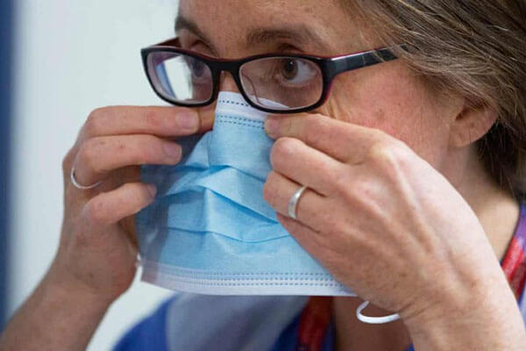

Slide 4
Introduction
Since late 2019, the new human coronavirus, Coronavirus disease 2019 (COVID-19), was initially reported in Wuhan, China, and spread rapidly all over the world, and has now become a pandemic and an international health concern.
Globally, the number of people infected with COVID-19 has reached to more than 178 million out of which more than 3.8 million were died due to this outbreak until June 19, 2021.

Slide 5
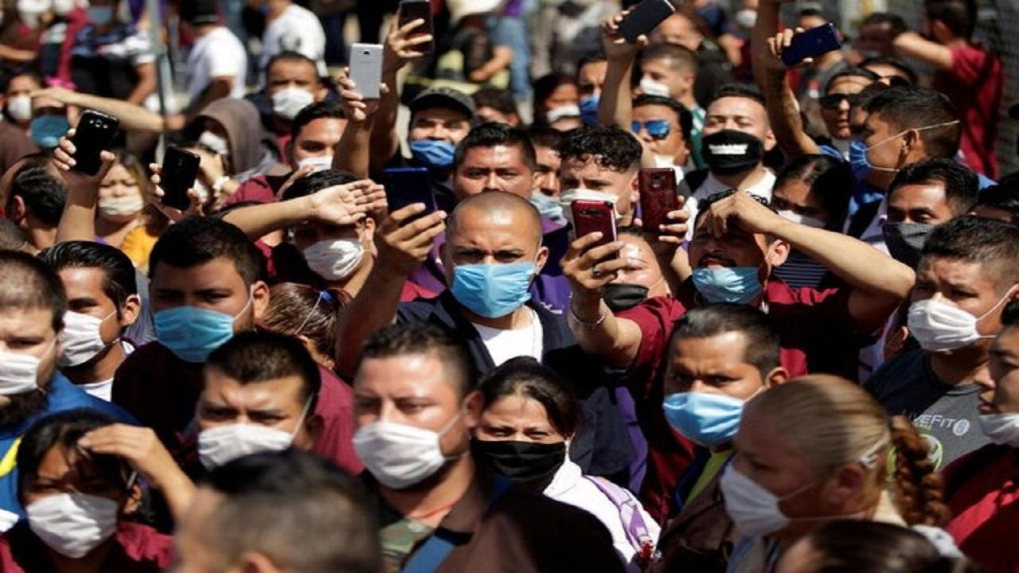

Slide 6
Introduction
In Iran, out of 3.03 million individuals infected by COVID-19, 82 thousand people lost their lives
all people of the community, from young to old and men and women, are at risk of COVID-19, age, and sex are two critical factors influencing the incidence or severity of the symptoms
The reports on the COVID-19 infected groups in most countries, including Iran showed that twice as many men as women are susceptible to COVID-19

Slide 7
Introduction
rate of Covid-19 in Ardabil, as one of the provinces of Iran, unlike other parts of the world, was higher in women than men.
This study is designed to identify the most important risk factors for COVID-19 among women with Covid-19 and healthy women to ultimately provide policies specific to women to prevent and control Covid-19

Slide 8
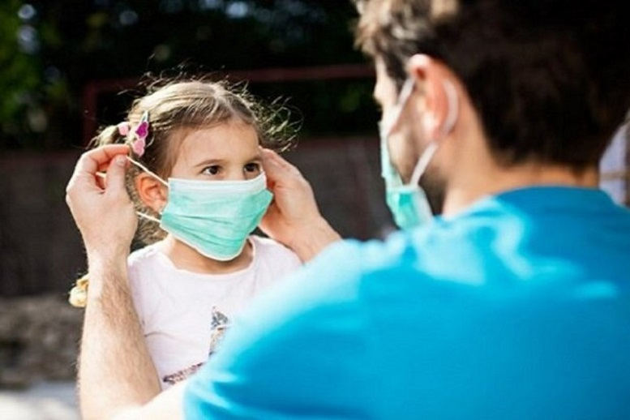

Slide 9
Materials and methods
Study area
This study was conducted in Ardabil province, one of the largest provinces in the north-west of Iran. According to the Statistical Centre of Iran, the total of Ardabil province inhabitants was estimated to be 1.3 million in 2019, wherein 48% were women.

Slide 10
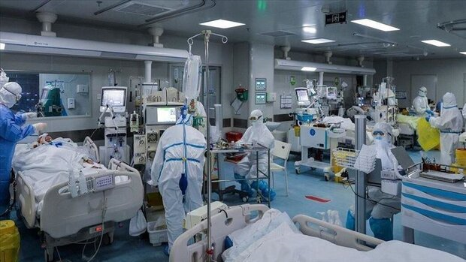

Slide 11
Materials and methods
Study design
The study design was an unmatched case–control study.
The source populations for this study were women who were living in Ardabil, Iran.

Slide 12
Materials and methods
Study populationlation
The cases were women hospitalized for Covid-19 in public and private hospitals designated as Covid-19 treatment centers from April 2 to October 22 2020.
The controls were healthy women who were not infected with Covid-19 at all.

Slide 13
Material and method
Sample sizeample size
the case group’s sample size was chosen as 261 people to examine exposure’s behavioral aspects.
The minimum control group’s sample size was calculated to be about 515 people.

Slide 14
Sampling technique
CasesSampling technique
Eight hospitals (7 public and one private) among the hospitals located in Ardabil province (13 public hospitals and 5 private hospitals), known as Covid-19 patients admitting hospitals, were selected as the case selection source

Slide 15
Sampling technique
ControlsControls
The control group consisted of women who had not been infected with Covid-19 since the Ardabil outbreak and had no recorded information about receiving inpatient services for Covid-19 or other infectious diseases in the last year.

Slide 16
Sampling technique
Eligibility criteria
Inclusion criteria for the case group included informed consent, being a resident of Ardabil and having information registered in the comprehensive system of Covid-19 patients.

Slide 17
Data collection tools and methods
The case and control groups’ health behaviours included three sections: contact and travel history during Covid-19 pandemic (last 14 days), observance of health protocols , and presence in different circles and places during the last 14 days.

Slide 19
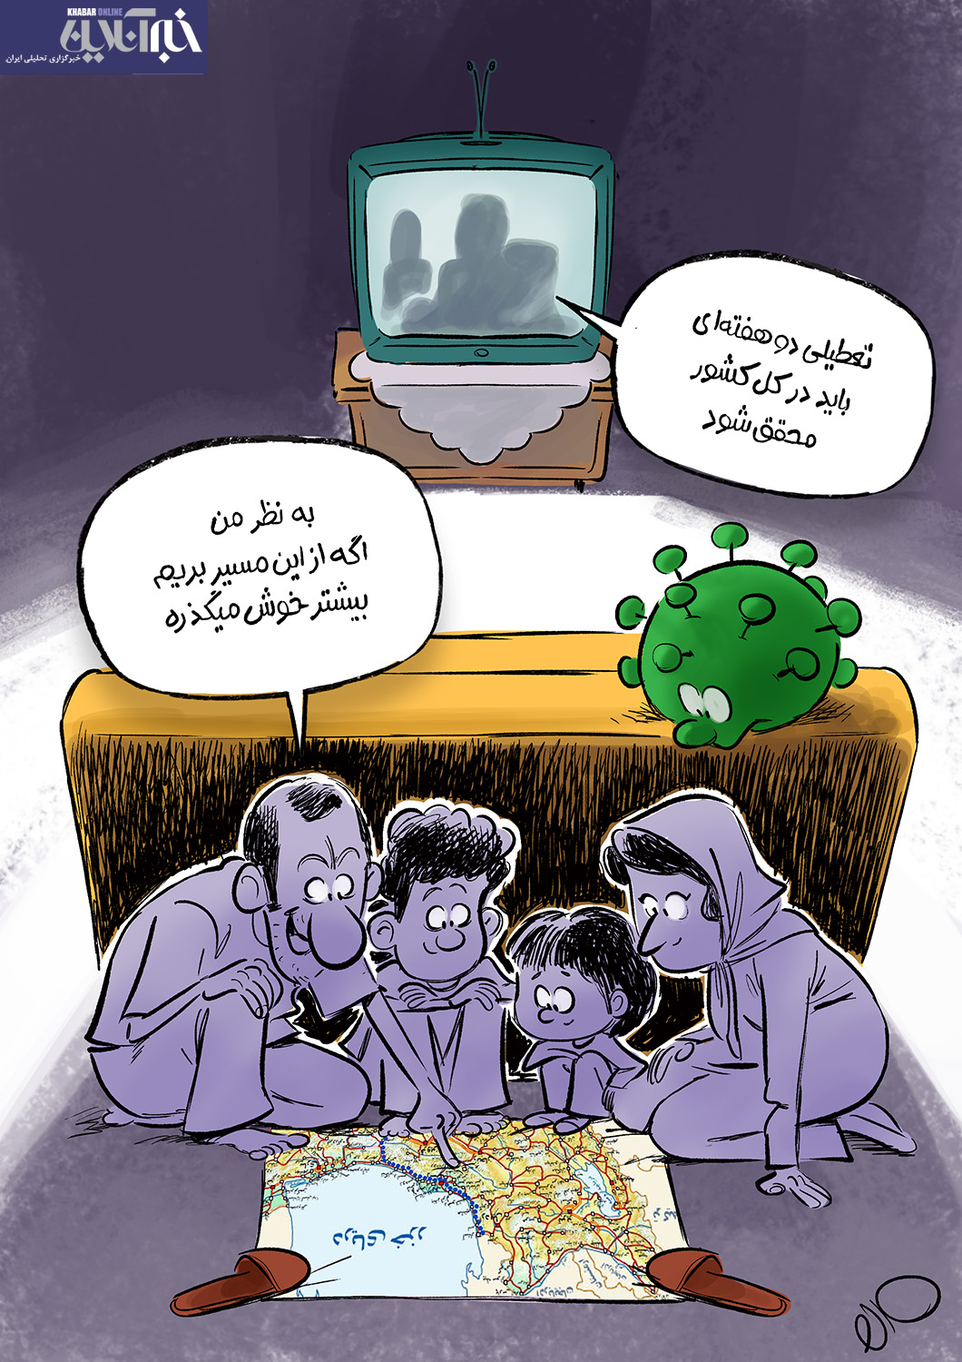

Slide 21
Demographic variables included age , place of residence , the underlying chronic disease including diabetes
(type 1 & 2) , cardiovascular disease, lung diseases (COPD), metabolic diseases, obesity, smoking , and body mass index , were collected for all participants

Slide 24
Data analysis and results:
Accurate Chi-square and Fisher tests were used to evaluate and compare the case and control groups in terms of demographic and contextual variables.

Slide 29
Conclusion
the higher rate of the fatality of women in Ardabil province due to COVID-19 could be resulted from the older average age, the prevalence of obesity, and failure in following the protective measures and healthy behaviours.
higher rate of the fatality of women in Ardabil province due to COVID-19 can be more health behaviors, including participation in gathering and also having underlying chronic diseases.
incomplete data on individuals affected by COVID-19 across rural areas and far regions, effect of some other demographic and/or socio-economic factors, which put women at higher risks of mortality due to COVID-19.

Slide 30
Conclusion
Future studies should be designed and conducted in order to support the health of women living with NCDs especially during the pandemic.
The priority in vaccination should be given to more vulnerable groups including old people and patients with NCDs and obesity.
Special emphasis should be given to the increase of women awareness on the importance of healthy diet and lifestyle.
The role of physical activity and maintaining the mental health of women during outbreak should be also taken into account.

Slide 31
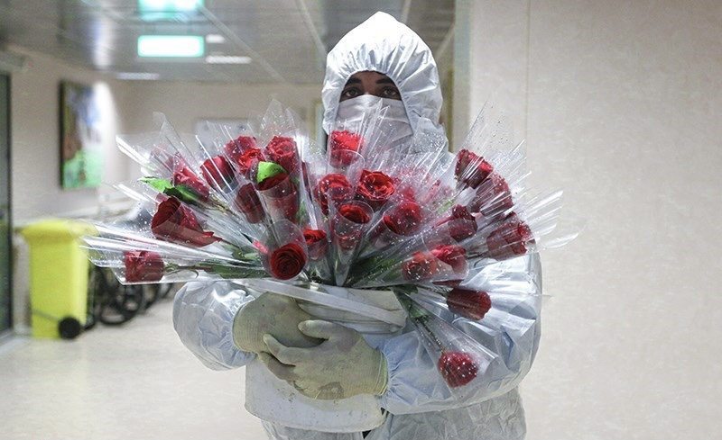
Thank you

