Slide 1
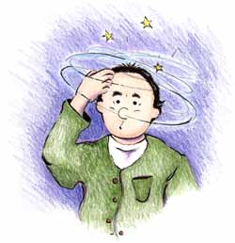
Dizziness and Vertigo
V. Abbasi, M.D.

Slide 2
Dizziness
Vertigo: illusion of movement
Ataxia: inability to co-ordinate movements (walking or of extremities), “feel as if drunk”
Dizziness
Non-specific term (lightheadedness, swimming sensation inside of head)
Different meanings to different people
Could mean
Vertigo - Syncope - Presyncope
Weak - Giddiness - Anxiety
Anemia - Depression - Unsteady

Slide 3
Syncope
Transient loss of consciousness with loss of postural tone
Presyncope
Lightheadedness-an impending loss of consciousness
Psychiatric dizziness
Dizziness not related to vestibular dysfunction
Disequilibrium
Feeling of unsteadiness, imbalance or sensation of “floating” while walking

Slide 5
Vertigo and Dizziness
Prevalence
1 in 5 adults report dizziness in last month
Increases in elderly
Worsened by decreased visual acuity, proprioception and vestibular input

Slide 6
Evaluation of the Dizzy Patient
What type of dizziness is it?
How long does it last? Continuous or episodic
Spontaneous or positional
Duration of vertigo if episodic
Are there otologic symptoms?
Are there focal neurological symptoms?

Slide 8
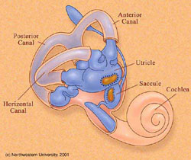
Vestibular Labyrinth
Pathophysiology
Complex interaction of visual, vestibular and proprioceptive inputs that the CNS integrates as motion and spatial orientation
3 semicircular canals
rotational movement
cupula
2 otolithic organs
utricle & saccule
linear acceleration
Macula

Slide 9
Vertigo and Dizziness
Normally there is balanced input from both vestibular systems
Vertigo develops from asymmetrical vestibular activity
Abnormal bilateral vestibular activation results in truncal ataxia

Slide 10
Vertigo and Dizziness
Nystagmus
Rhythmic slow and fast eye movement
Direction named by fast component
Slow component due to vestibular or brainstem activity
Slow component usually ipsilateral to diseased structure
Fast component due to cortical correction
Physiologic Vertigo
“motion sickness”
A mismatch between visual, proprioceptive and vestibular inputs
Not a diseased cochleovestibular system or CNS

Slide 11
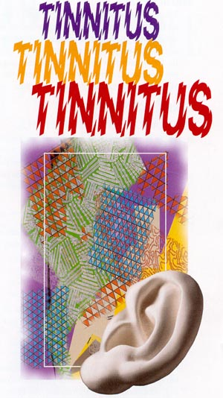
Otologic Symptoms in the Dizzy Patient
Hearing Loss: progressive, sudden SNHL,congenital, fluctuating
Tinnitus: continuous or episodic
Aural fullness
Ear pain, or chronic drainage
History of ear surgeries/infection

Slide 12
Focal Neurological Symptoms
Vertigo if secondary to cerebrovascular insufficiency is indicative of posterior circulatory problems
Visual loss
Loss of consciousness
Numbness especially if on one side
Weakness especially if on one side
Incoordination as if drunk
Difficulty swallowing
Slurring of the speech

Slide 13
Evaluation of the Dizzy Patient
Family History:
Hearing Loss
Vertigo Spells
Headaches or visual auras
Gait ataxia or imbalance

Slide 14
Vertigo-History
Is it true vertigo?
Autonomic symptoms?
Pattern of onset and duration
Auditory disturbances?
Neurologic disturbances?
Was there syncope?
Unusual eye movements?
Any past head or neck trauma?
Past medical history?
Previous symptoms?
Prescribed and OTC medications?
Drug and alcohol intake?

Slide 15
Vertigo-Physical Exam
Cerumen/FB in EAC
Otitis media
Pneumatic otoscopy
Tympanosclerosis or TM perforation
Nystagmus
Fundoscopic exam
Pupillary abnormalities
Extraocular muscles
Cranial nerves
Internuclear ophthalmoplegia
Auscultate for carotid bruits
Orthostatic vital signs
BP and pulse in both arms
Dix-Hallpike maneuver
Gross hearing
Weber-Rinne test
External auditory canal vesicles
Muscle strength
Gait and Cerebellar function

Slide 16
Nystagmus: Features of Peripheral
Spontaneous nystagmus from imbalance of signals from the right and left vestibular periphery
The resulting nystagmus is a combined torsional, horizontal.
Alexander’s law: Increased frequency and amplitude of nystagmus with gaze in direction of fast component, reverse effect with gaze opposite to the fast component.
Inhibited by fixation

Slide 17
Features of Central Nystagmus
Prominent with and without fixation
Can be purely vertical (always central), horizontal, or torsional, of have some combination
The rule is if the nystagmus is vertical (upbeat or downbeat), it is central i.e. not coming from the inner ear
Cerebellar: spontaneous downbeat with vertical amplitude increasing with horizontal gaze deviation
or brought out when placed in supine position

Slide 18
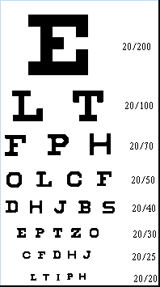
Bedside Tests of Vestibular Function: Dynamic Visual Acuity
Oscillopsia : perception of environment jumping up and down when walking.
Ask the patient: “Can you read the print on the cans while walking down the grocery store aisle?”
May be a sign of bilateral loss of VOR function
Horizontal passive rotation at 2 Hz. Normal is loss of 1 line of Snellen acuity card, bilateral vestibular loss will lose 5 lines.

Slide 19
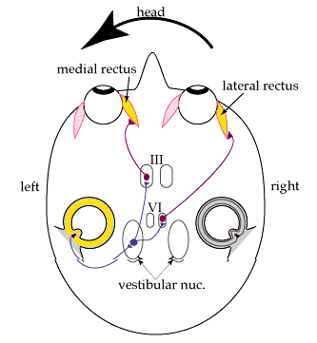
Bedside Tests of Horizontal VOR: Head Thrust Test
Rapid, high-acceleration head thrust with patient fixating on examiner’s nose
Corrective saccade (catch-up saccade) when head is rotated toward the affected vestibular periphery is positive
Positive in vestibular neuritis, gentamicin ototoxicity (bilateral), idiopathic and autoimmune vestibulopathy
May be normal to have slight VOR hypometria bilaterally in older patients

Slide 20
Vertigo-Characteristics
 | Peripheral | Central
Onset | Sudden | Usually slow
Severity of Vertigo | Intense | Usually mild
Pattern | Paroxysmal | Constant
Exac. by movement | Yes | Variable
Autonomic | Frequent | Variable
Laterality | Unilateral | Uni or bilat
Nystagmus | Horizontorotary | Any
Fatigable/Fixation | Yes | No
Auditory symptoms | Yes | No
TM | May be abnormal | Normal
CNS symptoms | Absent | Present

Slide 21
Vertigo-Differential Diagnoses
Etiologies of Vertigo
BPPV
Labyrintitis
Acute suppurative
Serous
Toxic
Chronic
Vestibular neuronitis
Vestibular ganglionitis
Ménière’s
Acoustic neuroma
Perilymphatic fistula
Cerumen impaction
CNS infection (TB, Syphillis)
Tumor (Benign or Neoplastic)
Cerebellar infarct
Cerebellar hemorrhage
Vertebrobasilar insufficiency
AICA syndrome
PICA syndrome
Multiple Sclerosis
Basilar artery migraine
Hypothyroidism
Hypoglycemia
Traumatic
Hematologic (Waldenstroms)

Slide 22
Peripheral Vertigo-Differential
Labyrinthine Disorders
Most common cause of true vertigo
Five entities
Benign paroxysmal positional vertigo (BPPV)
Labyrinthitis
Ménière disease
Vestibular neuronitis
Acoustic Neuroma

Slide 23
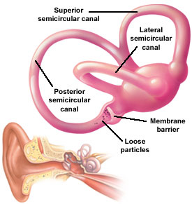
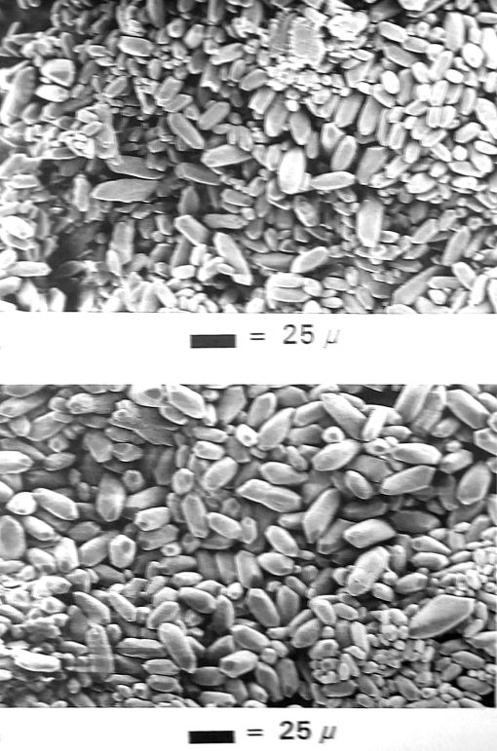
Benign Paroxysmal Positional Vertigo
Otolithic calcium carbonate crystals become loose, and fall into the posterior semicircular canal
Common with head trauma, older age, inner ear disease
One of the most common cause of vertigo seen in neurotology clinics, estimated at 20-30% of patients

Slide 24
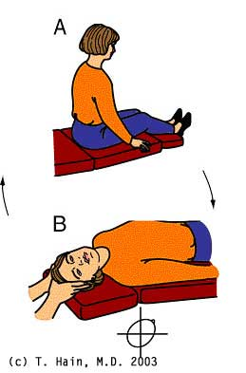
Benign Paroxysmal Positional Vertigo
Typical complaint: spells of vertigo when turning over in bed
No hearing loss or tinnitus
Usually a single position that elicits vertigo Horizontorotary nystagmus with crescendo-decrescendo pattern after slight latency period
Examine the patient for nystagmus and vertigo in the Dix-Hallpike position : head-hanging R and L
Vertigo lasts shorter than 1 minute
torsional nystagmus with upbeat component
Brought on only by positional changes
Latency of few seconds up to 45 sec
Fatigues with repeated testing

Slide 25
Modified Epley Maneuver

Slide 26
Epidemiology of BPPV
Lifetime prevalence of 3.2% in females and 1.6% in males
Of 100 unselected elderly patients, a prevalence of 9% was reported
Median duration of two weeks
Female preponderance likely reflects the association of migraine with BPPV
Association of BPPV with hypertension and hyperlipidemia
Vascular damage to the inner ear facilitates detachment of the otoconia

Slide 27
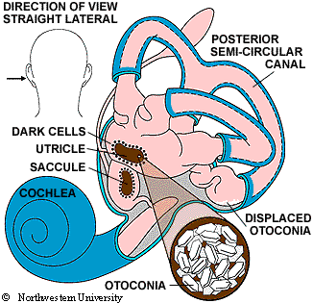
Otoconia in BPPV

Slide 28
Labyrinthitis
Associated hearing loss and tinnitus
Involves the cochlear and vestibular systems
Abrupt onset
Usually continuous
Four types of Labyrinthitis
Serous
Acute suppurative
Toxic
Chronic

Slide 29
Labyrinthitis
Serous
Adjacent inflammation due to ENT or meningeal infection
Mild to severe vertigo with nausea and vomiting
May have some degree of permanent impairment
Acute suppurative labyrinthitis
Acute bacterial exudative infection in middle ear
Secondary to otitis media or meningitis
Severe hearing loss and vertigo
Treated with admission and IV antibiotics

Slide 30
Labyrinthitis
Toxic
Due to toxic effects of medications
Still relatively common
Mild tinnitus and high frequency hearing loss
Vertigo in acute phase
Ataxia in the chronic phase
Common etiologies
-Aminoglycosides -Vancomycin
-Erythromycin -Barbiturates
-Phenytoin -Furosemide
-Quinidine -Salicylates
-Alcohol

Slide 31
Labyrinthitis
Chronic
Localized inflammatory process of the inner ear due to fistula formation from middle to inner ear
Most occur in horizontal semicircular canal
Etiology is due to destruction by a cholesteatoma

Slide 32
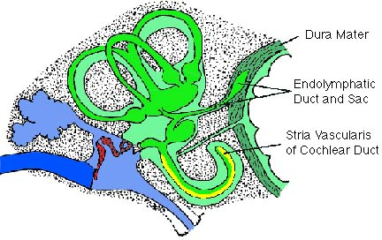
Meniere’s Disease
Symptoms: Fluctuating hearing loss, tinnitus, ear fullness, and vertigo. May have initially only hearing loss or only vertigo spells.
Possibly sudden falls (Tumarkin crisis)
Hearing loss, tinnitus, and aural fullness increase during the vertigo attack
Typically lasts 20 minutes or more in duration

Slide 33
Meniere’s Disease
On temporal bone histopathology, there is a distension of the entire endolymphatic system
Audiogram: often low-frequency sensorineural hearing loss that increases during attacks.

Slide 34
Meniere’s Disease: Tumarkin falls
In about 7-10% of Meniere’s disease, there are associated sudden falls “drop attacks”
No warning, sudden, violent fall without loss of consciousness
Subjective sensation of being pushed by an external force
Surgical ablation is curative of these dangerous and frightening drop attacks

Slide 35
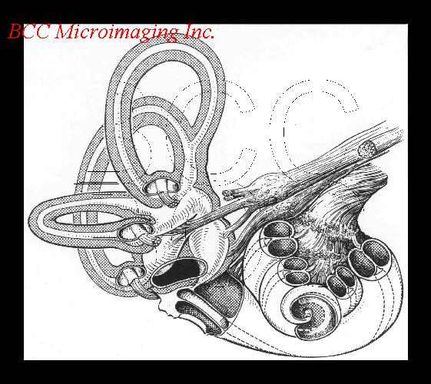
Meniere’s Disease Variant: Delayed Endolymphatic Hydrops
Delayed hydrops develops in an ear that has h/o profound SNHL years before (up to 70 years before)
Many years later: recurrent spells of vertigo of 20 minutes duration or longer
Often without accompanying otologic symptoms of aural fullness, increased tinnitus and hearing fluctuation
Can also have Tumarkin falls

Slide 36
Ménière Disease
First described in 1861
Triad of vertigo, tinnitus and hearing loss
Due to cochlea-hydrops
Unknown etiology
Possibly autoimmune

Slide 37
Ménière Disease
Often patients have eaten a salty meal prior to attacks
May occur in clusters and have long episode-free remissions
Usually low pitched tinnitus
Symptoms subside quickly after attack
No CNS symptoms or positional vertigo are present

Slide 38
Positional and Spontaneous Vertigo: Multiple Sclerosis
Vertigo is the initial symptom of MS in 5%, and presents in 50% of MS patients at some time in the course.
25% of patients with MS have caloric paresis
80% have eye movement abnormalities
Oftentimes abnormalities on ABR and occasionally retrocochlear hearing loss from involvement at the root entry zone near pons
May have any type of nystagmus

Slide 39
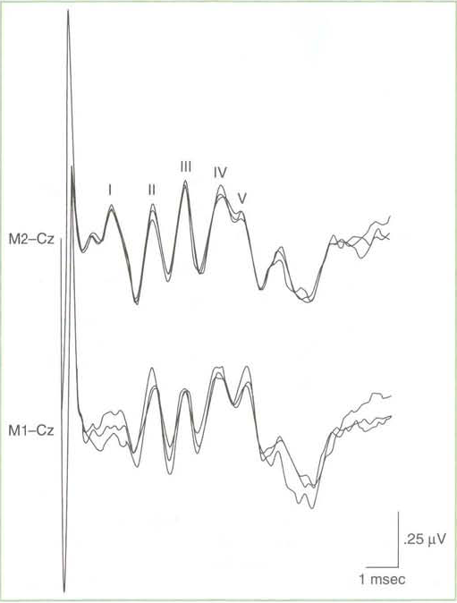
Brainstem aud itory evo ked potentials (BAEPs)

Slide 40
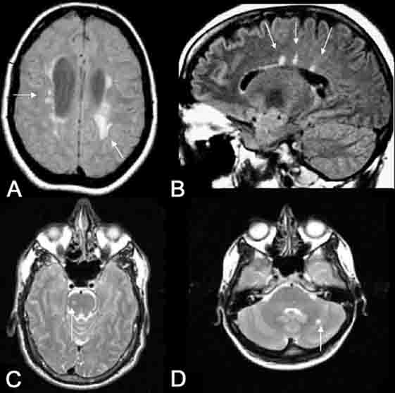
Positional and Spontaneous Vertigo: Multiple Sclerosis
Demyelinating disease of unknown etiology
Onset usually in 3rd and 4th decade of life
Common associated signs and symptoms: INO (internuclear ophthalmoplegia), optic neuritis, Llermitte’s sign, vibratory loss, spasticity, sensitivity to temperature
MRI with FLAIR: plaques

Slide 41
Migraine-associated Vertigo
Vestibular Meniere’s, migraine-associated vestibulopathy, benign paroxysmal vertigo
25% of patients with migraine have vertigo spells
Duration of the vertigo varies:
31% few min-2 hr
49% > 24 hrs
7% seconds
25% of patients with migraine have caloric paresis
Isolated vertigo without headache are termed migraine equivalent

Slide 42
Migraine-associated Vertigo
Migraine is an inherited, likely metabolic syndrome with multiple causes, likely autosomal dominant with variable penetrance
Always ask about the family history
Ask about h/o motion sickness (50%)
Ask about h/o altitude sickness
Ask about sensitivity to visual stimuli (bright lights/ patterns, computer work)

Slide 43
Migraine-associated Vertigo
Ask about h/o recurrent abdominal pains or cyclical vomiting as child, which is usually migraine equivalent
Ask women specifically regarding menses: some will call migraine headaches “PMS”
Migraine-associated vertigo often has a catamenial component, or worsened by OCP in women

Slide 44
International Headache Society Criteria for Migraine Headaches
At least 5 attacks fulfilling B-D
B. Headache lasting 4-72 hrs
C. At least 2 of: unilateral, pulsating, moderate or severe, aggravation by physical activity
D. At least one of N/V, photophobia and phonophobia
Other causes ruled out

Slide 45
Variants of Migraine
Migraine visual aura: Visual aura may occur isolated without headache: fortification spectra, scotoma, stars, patterns of colored lights lasting usually 15-20 minutes
Retinal migraine: retinal artery vasospasm which can cause monocular blindness: prophylaxis with verapamil
Benign paroxysmal vertigo of childhood: recurrent spells of vertigo in child is usually migraine, may or may not have H/A

Slide 46
Association between Migraine and Vestibulopathy
Tumarkin falls may be associated with migraine
Out of 55 patients with Tumarkin falls, 6 had >1yr h/o normal hearing
5 out of 6 had h/o migraine
Tumarkin falls are known to localize to the vestibular periphery since surgery is curative

Slide 47
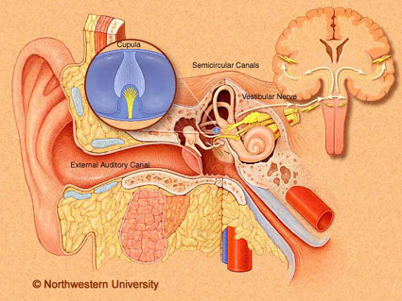
Vestibular Neuritis
Subacute onset of vertigo, often with nausea and vomiting
Vertigo lasts a few days, and crescendos in few hours, and decreases in severity with time
Suspicion for viral cause but evidence for ischemic causes
Mild vertigo may last for several weeks
May have auditory symptoms
Highest incidence in 3rd and 5th decades
Temporal bone histopathology: Scarpa’s ganglion neuronal loss

Slide 48
Vestibular Ganglionitis
Usually virally mediated-most often VZV
Affects vestibular ganglion, but also may affect multiple ganglions
May be mistaken as BPPV or Ménière disease
Ramsay Hunt Syndrome
-Deafness -Vertigo
-Facial Nerve Palsy -EAC Vesicles

Slide 49
Acoustic Neuroma
Peripheral vertigo that ultimately develops central manifestations
Tumor of the Schwann cells around the 8th CN
Vertigo with hearing loss and tinnitus
With tumor enlargement, it encroaches on the cerebellopontine angle causing neurologic signs
Earliest sign is decreased corneal reflex
Later truncal ataxia
Most occur in women during 3rd and 6th decades

Slide 50
Central Vertigo-Differential
Central Vertigo
Vertebrobasilar Insufficiency
Atheromatous plaque
Subclavian Steal Syndrome
Wallenberg Syndrome
Cerebellar Hemorrhage
Multiple Sclerosis
Head Trauma
Neck Injury
Temporal lobe seizure
Vertebral basilar migraine
Metabolic abnormalities
Hypoglycemia
Hypothyroidism

Slide 51
Vertebrobasilar Insufficiency
Important causes of central vertigo
Related to decreased perfusion of vestibular nuclei in brain stem
Vertigo may be a prominent symptom with ischemia in basilar artery territories
Unusual for vertigo to be only symptom of ischemia

Slide 52
Vertebrobasilar Insufficiency
Most commonly will also have:
-Dysarthria -Ataxia -Facial numbness
-Hemiparesis -Diplopia -Headache
Tinnitus and hearing loss unlikely
Vertical nystagmus is characteristic of a (superior colliculus) brain stem lesion

Slide 53
Vertebrobasilar insufficiency
20% of all strokes are in the vertebrobasilar distribution
Usually from atherosclerotic disease, but 1/5 of infarcts may be cardioembolic
Common cause of episodic, spontaneus vertigo of abrupt onset in older patients
Several minutes (3-4 min) duration is always suspicious for TIA

Slide 54
Vertebrobasilar insufficiency
Visual (diplopia/ illusions, field defects in 69%
Drop attacks in 33%
Imbalance/ incoordination in 21%
Extremity weakness in 21%
Confusion in 17%
Headache in 14%
Hearing loss in 14%
Loss of consciousness in 9.5%
Extremity numbness in 9.5%
Dysarthira in 9.5%
Tinnitus in 9.5%
Perioral numbness in 5%

Slide 55
Drop attack
Abruptly falls without warning, but does not loose consciousness
Believed to be caused by transient quadraparesis due to ischemia at the pyramidal decussation

Slide 57
Subclavian Steal Syndrome
Rare, but treatable
Arm exercise on side of stenotic subclavian artery usually causes symptoms of intermittent claudication
Blood is shunted away from brainstem into ipsilateral vertebral artery
Classic history occurs only rarely

Slide 58
Stroke syndrome with vertigo: Wallenberg syndrome
Dorsolateral medullary syndrome
PICA (posterior inferior cerebellar artery)
Vertebral atherosclerotic disease
(artery to artery emboli) prior to takeoff
Consider vertebral dissection
Look for h/o neck trauma or manipulation

Slide 59
Wallenberg symptoms
Right Dorsolateral medullary stroke
Nystagmus and vertigo (vestibular nuclei)
Difficulty swallowing, hoarse voice, absent gag on R (nucleus ambiguus)
Difficulty limb coordination on the right FTN, HTS (right cerebellum)
On walking, veers and falls to the right
Pain and temperature loss on right face and left leg, trunk, arm (spinothalamic)
Right Horner’s: ptosis, miosis, anhydrosis (reticulospinal fibers in lateral medulla)

Slide 60
Wallenberg Syndrome
Occlusion of PICA
Relatively common cause of central vertigo
Associated Symptoms:
-nausea -vomiting -nystagmus
-ataxia -Horner syndrome
-palate, pharynx and laryngeal paresis
-loss of pain and temperature on ipsilateral face and contralateral body

Slide 61
Stroke syndrome with vertigo: Anterior inferior cerebellar artery
Vertigo
Tinnitus, hearing loss secondary to infarct of cochlea/nerve or cochlear nucleus
Ataxia
Facial paralysis and numbness
Ispilateral Horner’s

Slide 62
Stroke syndrome with vertigo: Labyrinthine infarction
Occlusion of the internal auditory artery
Sudden, profound hearing loss
Acute onset of spontaneous vertigo lasting days
Consider the diagnosis in older patients with h/o TIA, stroke, or atherosclerotic vascular disease

Slide 63
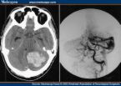
Cerebellar Hemorrhage
Etiology is hypertensive vascular disease in 2/3 of patients
Acute onset of vertigo, nausea, and vomiting and severe headache, inability to stand
Spontaneous or gaze evoked nystagmus, dysmetria, truncal ataxia
Often requires prompt evaluation and surgical decompression to prevent progression to coma or even death from herniation
Motor-sensory exam usually normal
Gait disturbance often not recognized because patient appears too ill to move

Slide 64
Head and Neck Trauma
Due to damage to the inner ear and central vestibular nuclei, most often labyrinthine concussion
Temporal skull fracture may damage the labyrinth or eighth cranial nerve
Vertigo may occur 7-10 days after whiplash
Fistula may provide direct route to CNS infection

Slide 65
Vertebral Basilar Migraine
Syndrome of vertigo, dysarthria, ataxia, visual changes, paresthesias followed by headache
Distinguishing features of basilar artery migraine
-Symptoms precede headache
-History of previous attacks
-Family history of migraine
-No residual neurologic signs
Symptoms coincide with angiographic evidence of intracranial vasoconstriction

Slide 66
Duration of vertigo
Duration
BPPV Seconds, always < 1 min
VBI Few minutes,
± focal neurological signs
Migraine Varies sec, minutes, hours or days
Meniere’s 20 minutes to hours
Vest.neuritis Days
Stroke Days

Slide 67
Metabolic Abnormalities
Hypoglycemia
Suspected in any patient with diabetes with associated headache, tachycardia or anxiety
Hypothyroidism
Clinical picture of vertigo, unsteadiness, falling, truncal ataxia and generalized clumsiness

Slide 68
Management
Severe Ménière disease may require chemical ablation with gentamicin
Attempt Epley maneuver for BPPV
Mainstay of peripheral vertigo management are antihistamines that possess anticholinergic properties
-Meclizine -Diphenhydramine
-Promethazine -Scopolamine

Slide 69
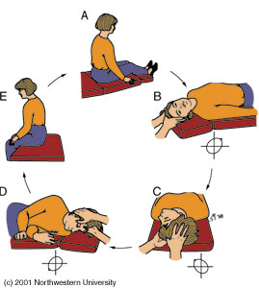
Epley Maneuver

Slide 70
Epley Maneuver
University of Baltimore
107 patients
Diagnosed with BPPV
Right ear affected 54%
Posterior semicircular canal in 105 patients
Treated with 1.23 treatments
Successful in 93.4%
Laryngoscope. 1999 Jun;109(6):900-3

Slide 71
Summary
Ensure you understand what the patient means by “dizzy”
Try to differentiate central from peripheral
Often there is significant overlap
Not every patient needs a head CT
Central causes are usually insidious and more severe while peripheral causes are mostly abrupt and benign
Most can be discharged with antihistamines

